Slide 1

Pairing Coordination & Strategy: A Year of Population Health
Presenters:
Susan Goudie-Adams, LPN | Patient Care Coordinator, Chronic Care Manager
Jackie Caba | CHW, Population Health Specialist

Slide 2
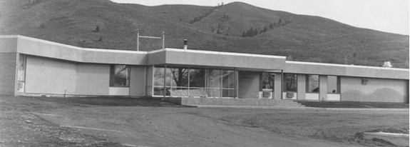
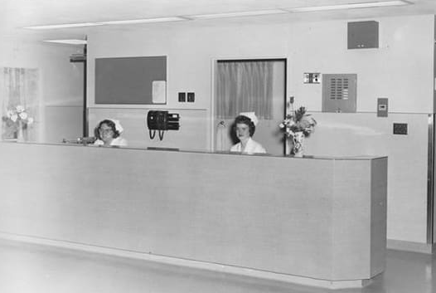
Overview of Adams County Health Center
Starting out as the Council Hospital, this facility met the full service & emergent healthcare needs for our rural community. The hospital later turned into a skilled nursing home for area residents.
In April 2002, what is now known as ACHC, became a free-standing Rural Health Clinic. In December 2004, ACHC became a Federally Qualified Health Center.
Currently, ACHC is a multidisciplinary clinic offering: Primary Care, Dental, Pharmacy, Laboratory, Optometry, Behavioral Health, Physical Therapy, Diabetes Care & Prevention Programs, Immunizations, Care Management, and Outreach & Enrollment Assistance.

Slide 3

Moving from Volume to Value
Population Health brings the
data lens: identifying gaps, tracking performance, and guiding outreach.
Community Health Workers close the loop— addressing social determinants and barriers, building trust, and facilitating resources & education.
Care Management translates that strategy into action: care planning & coordination, engaging patients in their care, ensuring follow-up & monitoring.
Notes:
I’d like to walk you through what implementation has looked like over the past year—what we set out to do, how we adapted along the way, and what impact we’re starting to see.

Slide 4
Population Health Implementation

Slide 5



Starting Points
Clean Up
Identify Problems & Breakdowns
Improve Efficiency
Attribution
Patients Not Seen
Department Crossover
Real-time look at data/metric changes
Review reporting & registries
Outreach Expansion
Target Populations
Pre Visit Planning
Increase Staff Engagement
Notes:
Pop Health Implementation – “So now what..?” 3 main focuses to start, go hand in hand

Slide 6
Phase 1:
Utilizing metric-based reports to identify patients
  not seen in over 2 years,
  patient’s unassigned/incorrectly assigned to a PCP,
  review patient lists for Providers who have left our Organization
Even patients that do not see our Medical dept can be included in our Population due to seeing other service lines we offer
We’ve worked to educate the importance of the PCP field, how it affects reporting & worklists
Clean Up
Attribution
Patients Not Seen
Department Crossover
Notes:
Pop Health Implementation – “So now what..?” 3 main focuses to start, go hand in hand

Slide 7
Phase 2:
Since implementing Population Health tools & strategies, it’s given us the opportunity to identify and adapt or pivot much more quickly and with greater trust in the accuracy of our reports.
We can monitor changes we make more effectively, often seeing report movement in 24 hours, when our dashboard updates, where previously so many of our reports were updated weekly & dependent on Claims data.
Identify Problems & Breakdowns
Real-time look at data/metric changes
Review reporting & registries
Notes:
Pop Health Implementation – “So now what..?” 3 main focuses to start, go hand in hand

Slide 8
Phase 3:
Expanded Outreach communication modalities utilizing our Patient Portal and Text & Email to better meet patient’s where they’re at.
Reaching specific populations to increase Preventive Screenings – i.e. Mammogram campaigns for uninsured women to utilize grant funding.
Including Staff in the creation and cadence of reporting, giving time back to Clinical Staff through Pre Visit Planning efforts.
Improve Efficiency
Outreach Expansion
Target Populations
Pre Visit Planning
Increase Staff Engagement
Notes:
Pop Health Implementation – “So now what..?” 3 main focuses to start, go hand in hand

Slide 9
Challenges and Initiatives

Slide 10
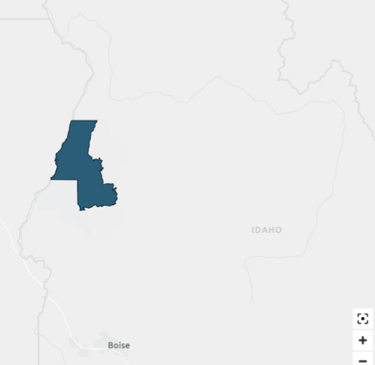
Current Challenges
  Spreadsheets vs. System (manual vs. electronic)
  Patient Portal – Health & Internet Literacy
  Multiple Service Lines - impact attribution efforts
  Rural Barriers
  Accuracy of data mapping platforms (Azara, NextGen PH Module)

Slide 11
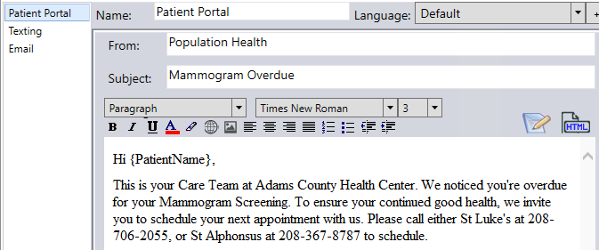
Enhancing Outreach
  Current Outreach Campaigns:
  Diabetic Patients Due For A1c/Check
  Uncontrolled HTN
  Overdue Breast Cancer Screening
  Overdue Diabetic Eye Exam
  Patients w/Multiple Chronic Conditions
  “Near Due” Wellness Visits
  Future:
  Preventive Screenings for Uninsured Patients
  Cervical Cancer, Breast Cancer, CRC

Slide 12

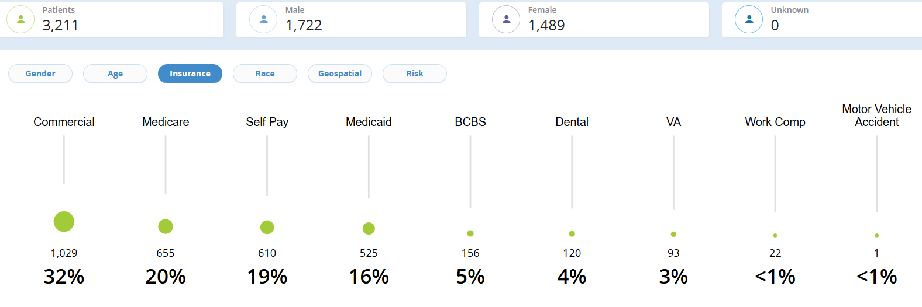
Reporting Meets Outreach
Making Data Actionable
Population Health Meets Community
Ex: Identifying MA patients who will lose coverage next year, and proactively send outreach communications, opportunities to schedule with CHW

Slide 13
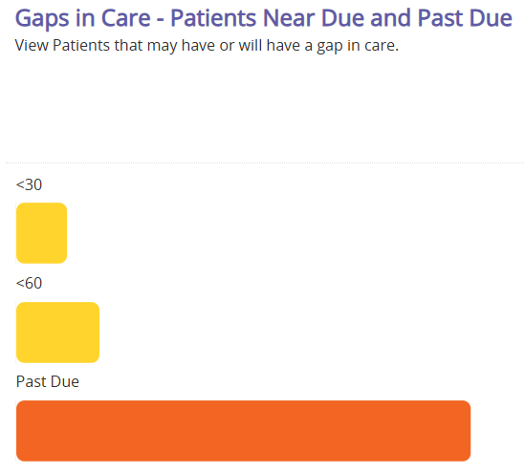
Redesigning Recall
  Enhanced recall efforts through revising Medicare AWV and Child & Adolescent Well Care reports
      Now looking forward 90 days
  Created a baseline to monitor scheduling improvement

Slide 14
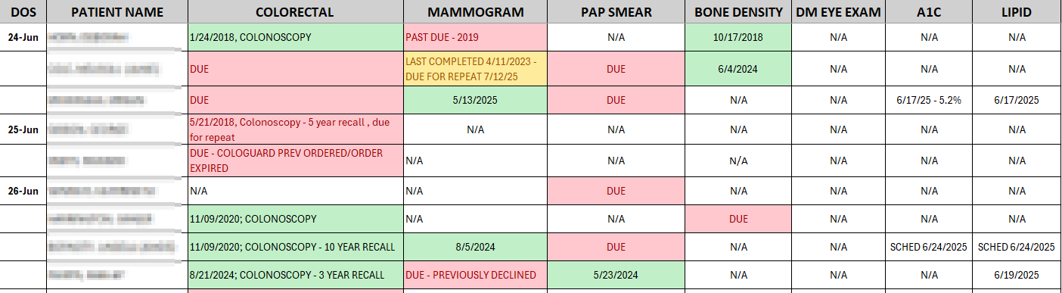
Pre Visit Planning
  Identify care gaps before the visit
  Empower MAs and nurses to prep charts
  Reduce missed opportunities for preventive and chronic care
Notes:
Pre Visit Report: select appointment types & age range, tied to HEDIS measures - review Idaho Health Data Exchange/EPIC/scanned documents to create orders/close gaps
Spreadsheet for Nursing Staff: prepared the Thursday before the next week’s appointments - showing patient’s care gaps reviewed/updated/status
Staff feedback: improved efficiency, reduced duplication, stronger engagement

Slide 15
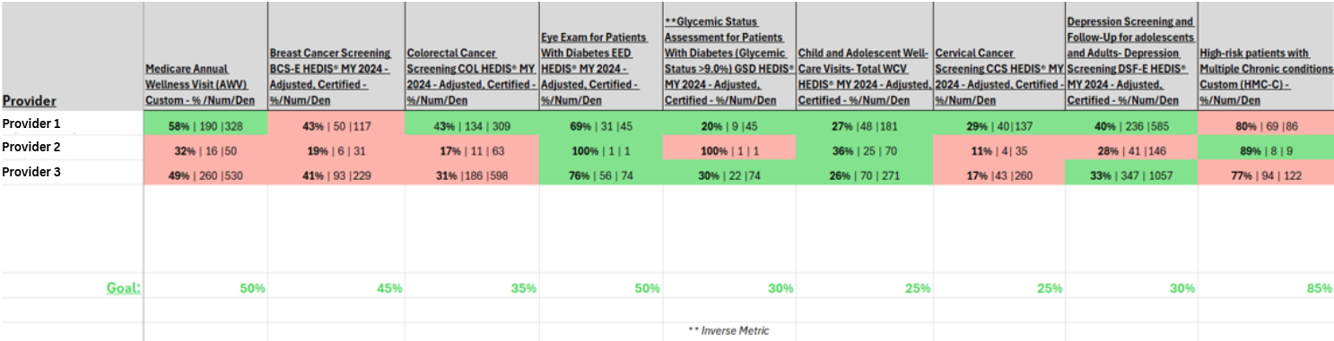
Buy In + Engagement
  Quarterly Updates to Providers
  Side-by-side comparisons with panel insights

Slide 16
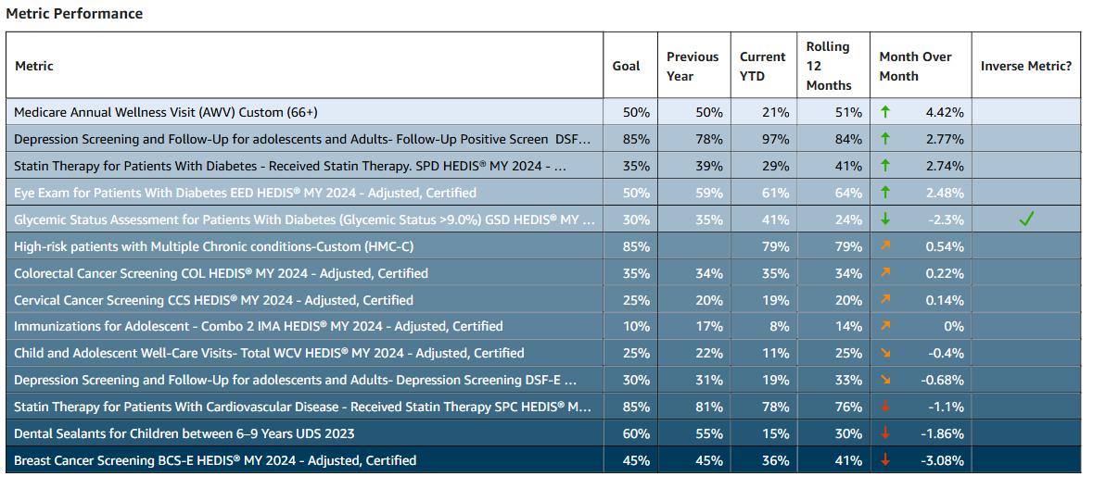
Buy In + Engagement
  Metrics review every other month at QI meetings

Slide 17
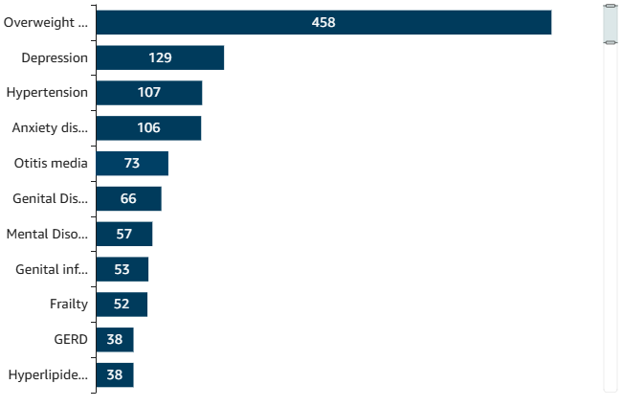
Looking Ahead
  Condition-specific opportunities to impact patient care
  Implement Care Guidelines
  Improve post-visit record follow-up/gap closures

Slide 18
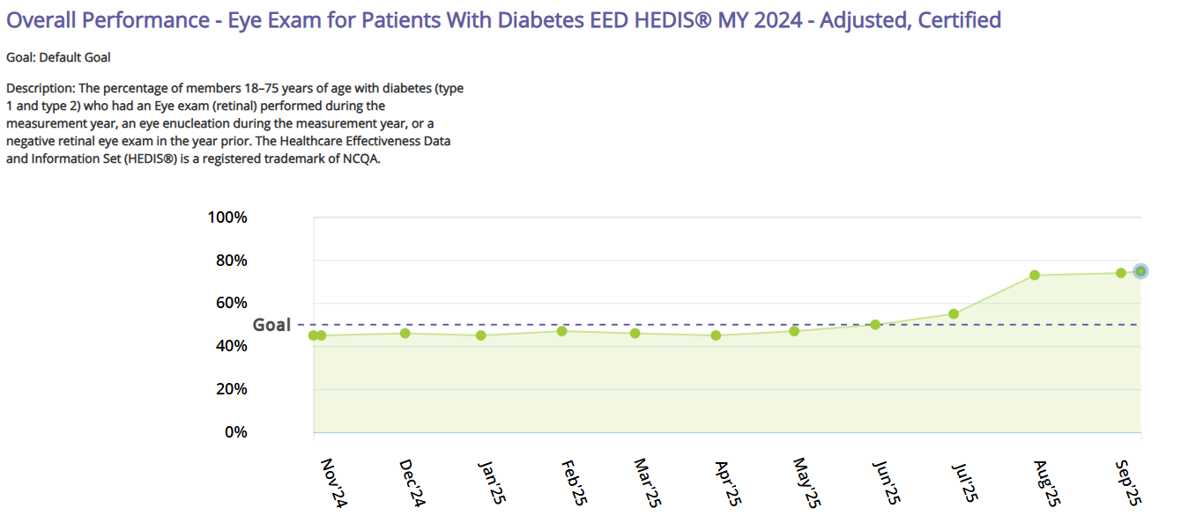
An Eye on Excellence
  Population Health tools were key in correcting our historical DM Eye Exams that were not being captured in reporting, and resulting in lower numbers & inaccurate patient registries
Notes:
DM Eye Exams improved 17%+ once codes & mapping were updated/fixed.

Slide 19
Care Management

Slide 20

Transitional Care Management (TCM)
Chronic Care Management (CCM)
Principal Care Management (PCM)
Community Health Integration (CHI)
What Care Management Encompasses

Slide 21

Collective
St. Luke’s Epic
St. Al’s Epic
Connections with Facility Staff
Transitional Care Management (TCM) Tools

Slide 22

Chronic Care Management (CCM) & Principal Care Management (PCM)
CCM - Chronic Conditions (2 or more)
PCM – Chronic Conditions (1)
  These are our patients often needing the most help.
  Population Health – two sides of coin

Slide 23

Community Health Integration (CHI)
Contributors to Gaps in Population Health
  Social Drivers of Health (SDOH)
    Transportation
    Medications
    Medical Supplies
    Housing
    Utilities
    Clothing

Slide 24
Full Circle
Improves patientcare
Decreases hospitalization
Decreases patient cost
Improves pt. engagement
Provides support to patients
Efficiency with scheduling

Slide 25
Questions?

Slide 26
Susan Adams, LPN
208-253-4242 Ext. 1011
susang@achcid.org
Jackie Caba
208-253-4242
jackiec@achcid.org
Thank you!

Slide 27
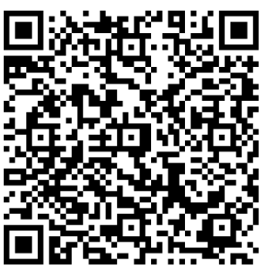
Session Survey:

