Slide 1


Family Caregivers in Idaho
Essential Partners in Care
3rd Annual Idaho Learning Collaborative
Resilience in a Changing Health Ecosystem
Wednesday, Nov 5, 2025
Notes:
Introduce panel

Slide 2
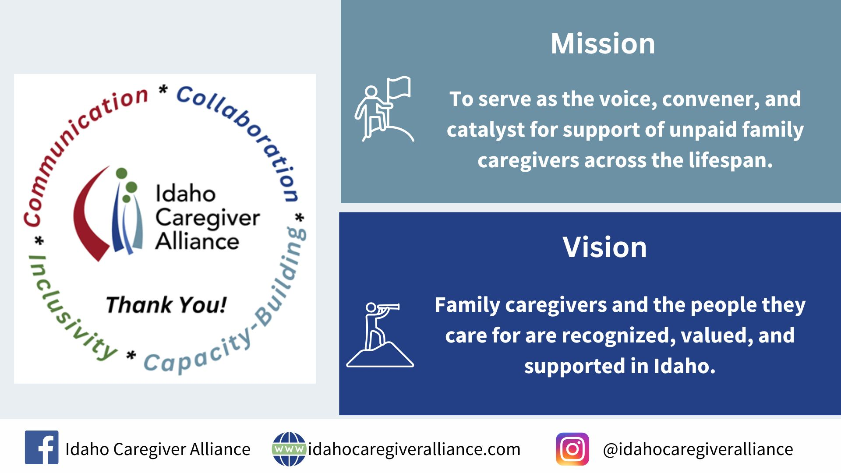

Slide 3
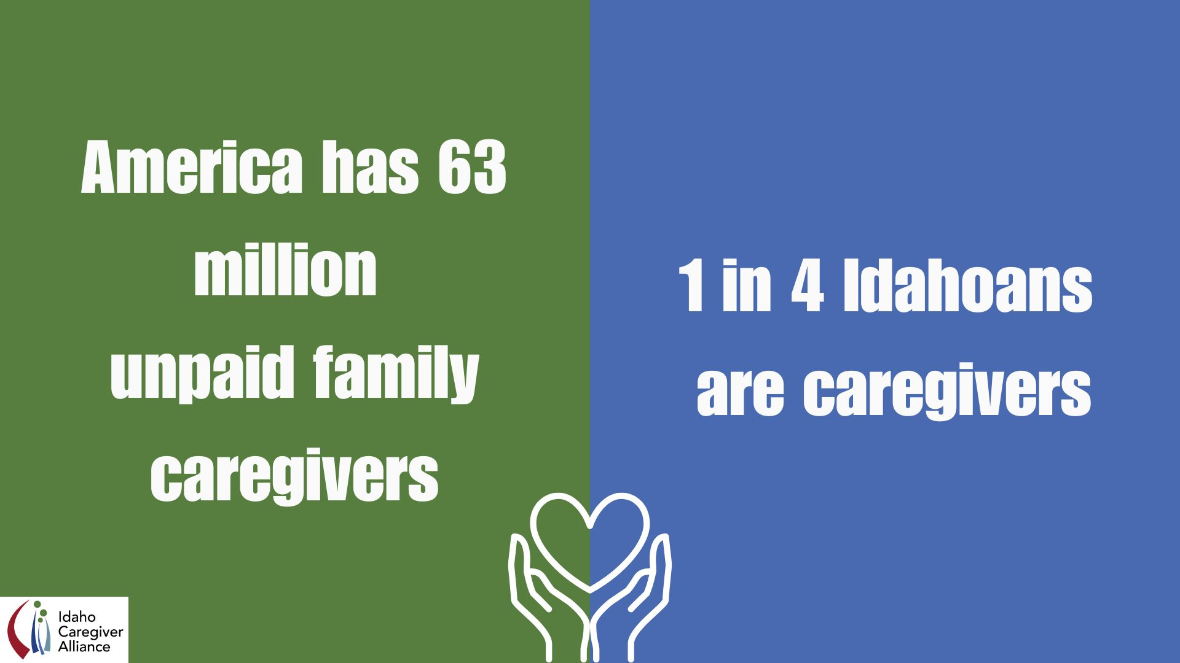
Notes:
AR

Slide 4
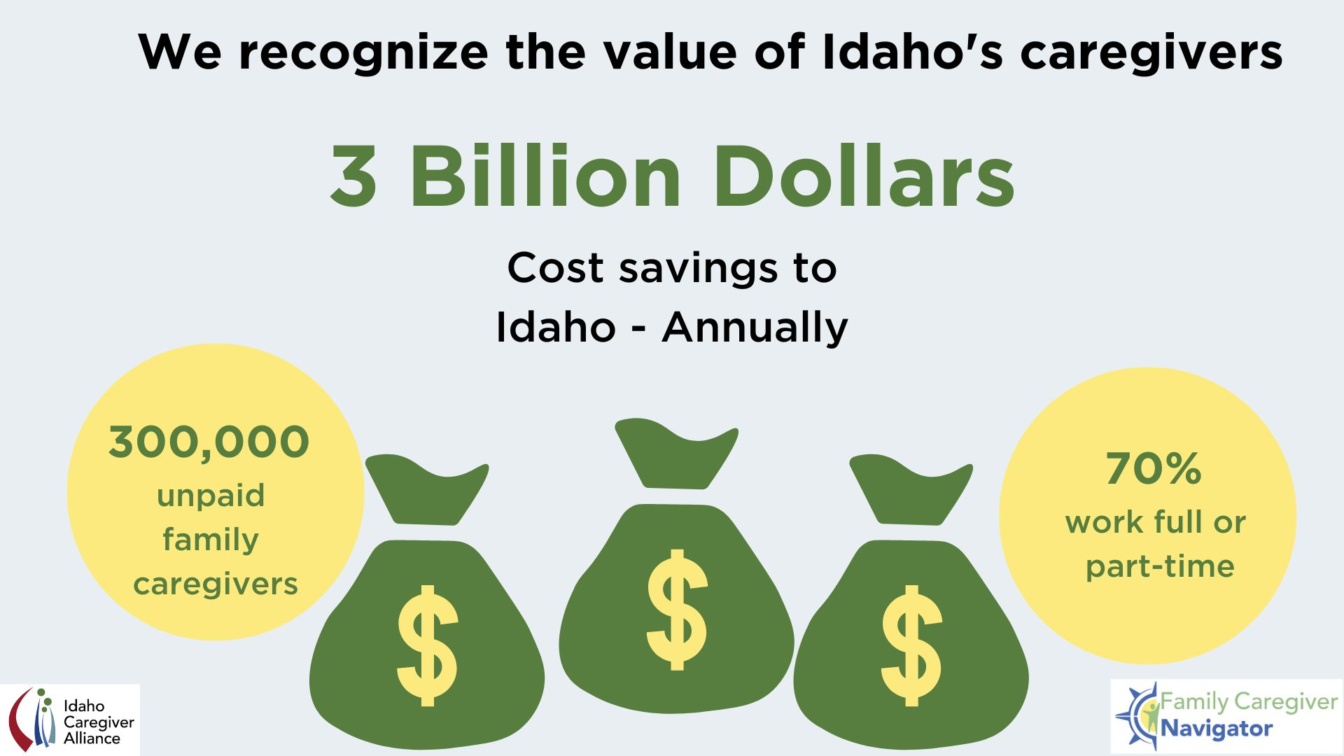
We recognize the value of Idaho’s Caregivers
$2,000,000,000 Cost Savings to Idaho- Annually
300,000 unpaid family caregivers
70% work full or part-time
201 million hours of unpaid care annually
Notes:
AR
Idaho numbers
We recognize the value that the 300,000 unpaid family caregivers offers Idaho. If we are employers we need to develop caregiver friendly benefits and supports because we know that 70% of or Idahoan caregivers are still working a part-time or full time job,
https://www.aarp.org/ppi/info-2015/valuing-the-invaluable-2015-update.html

Slide 5

Notes:
AR

Slide 6
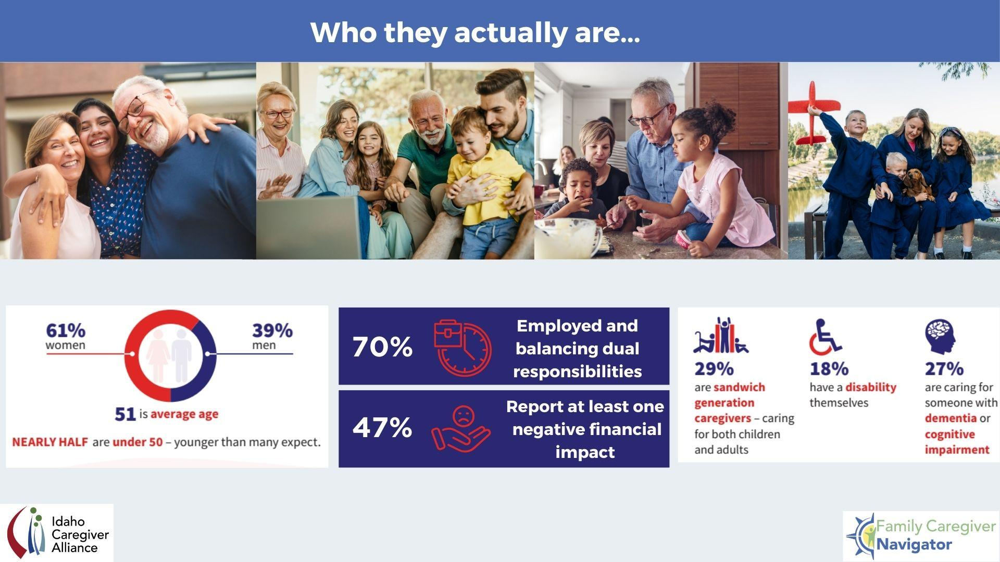

Slide 7
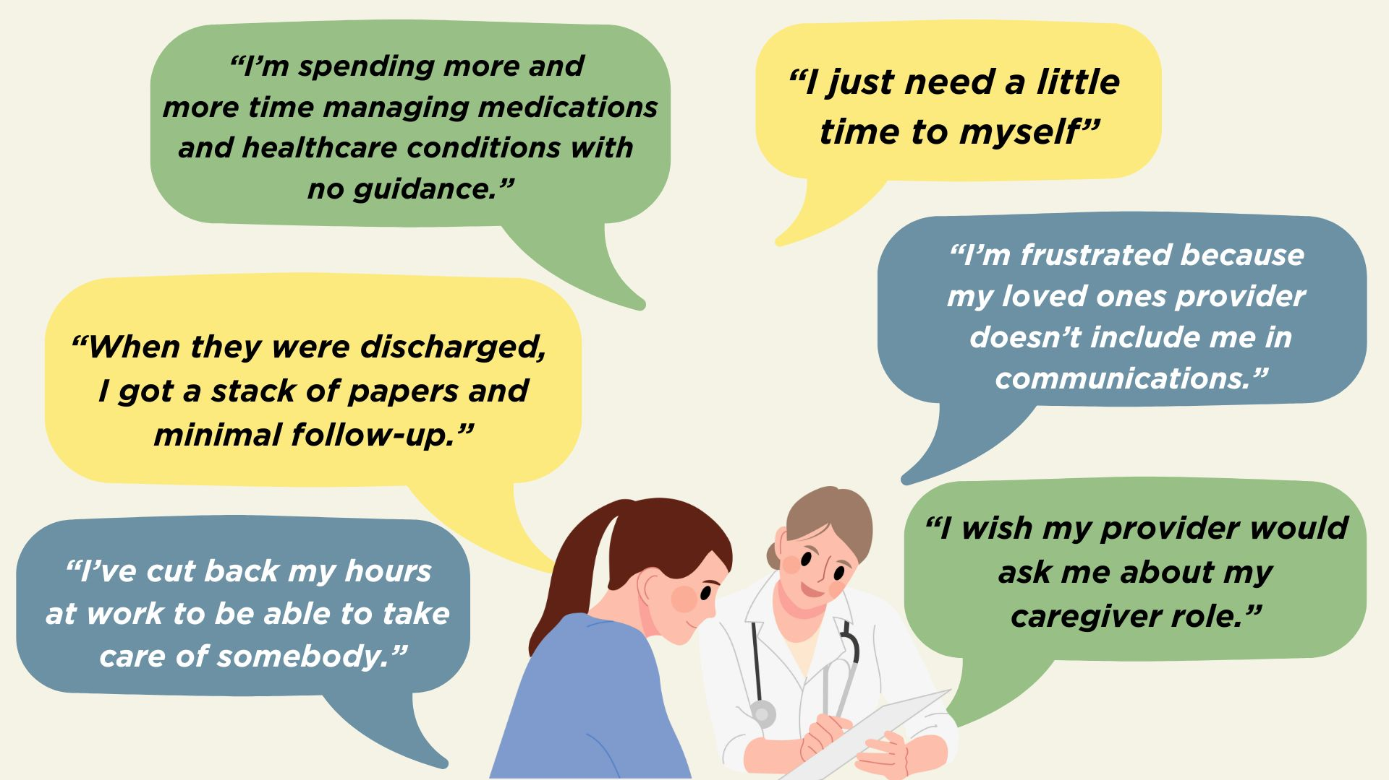

Slide 8
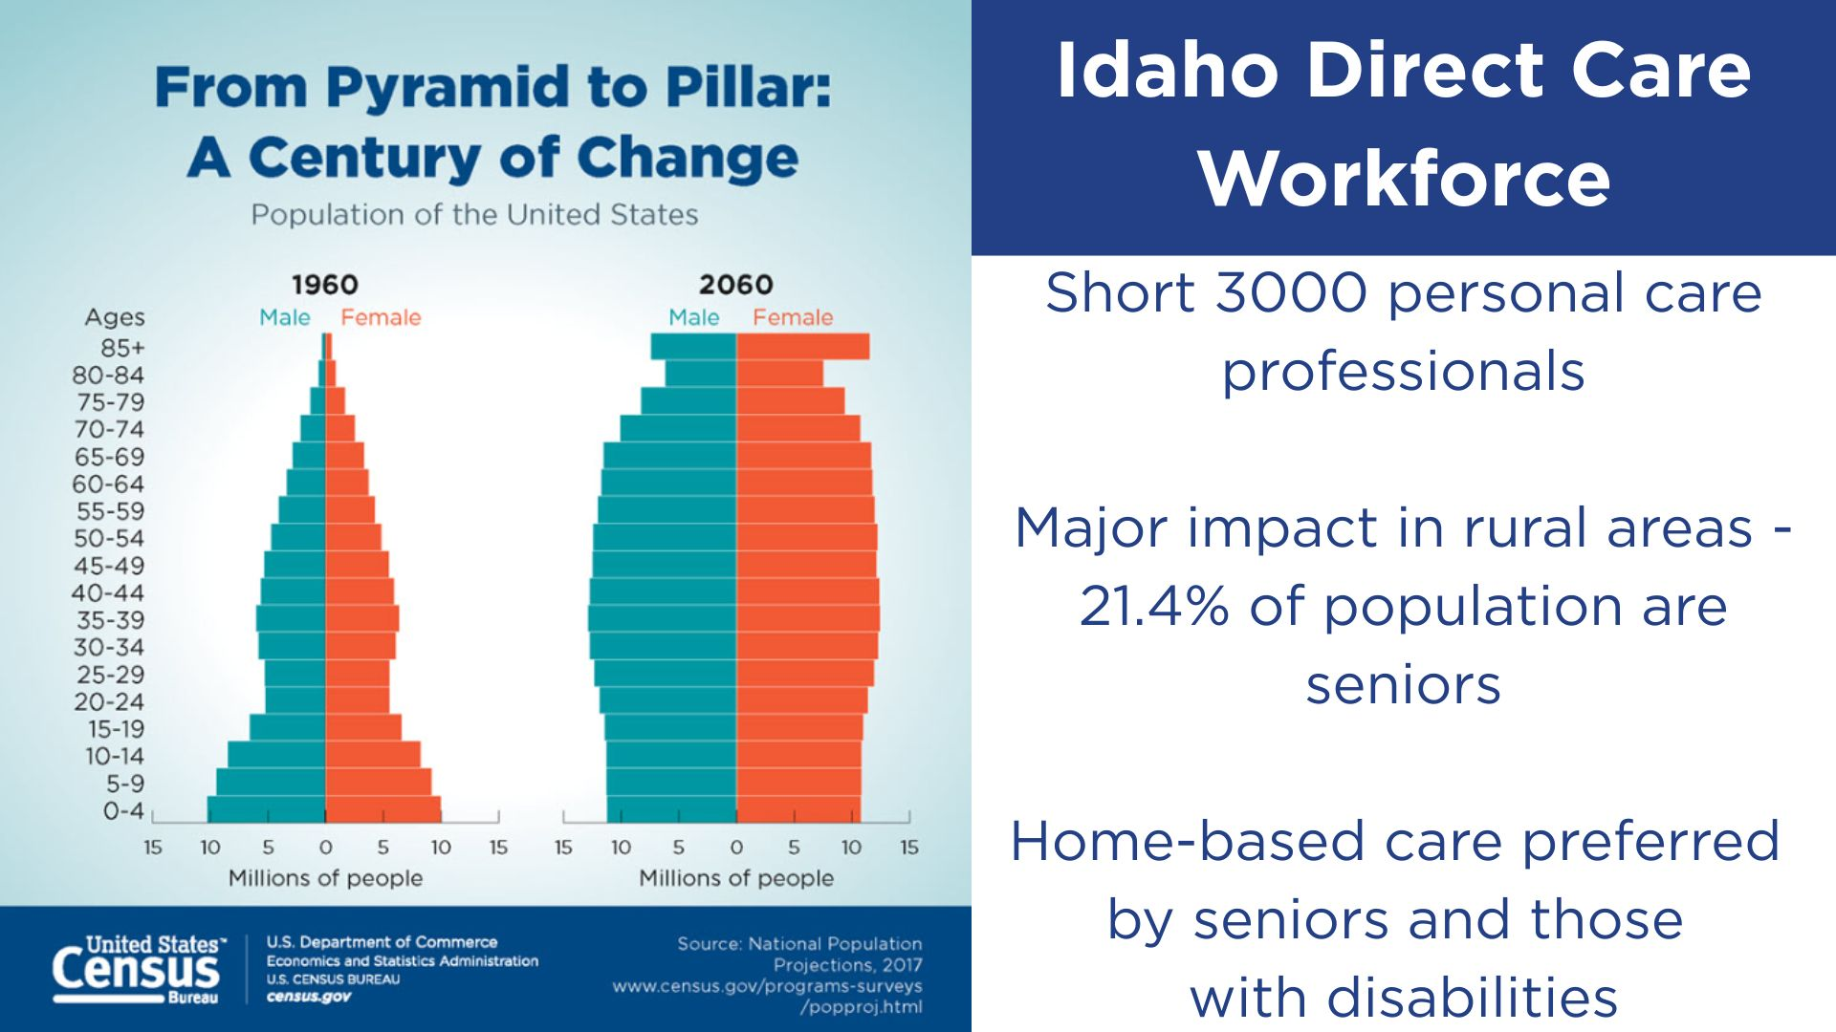
Idaho Direct Care Workforce
Short 3000 personal care professionals
Major impact in rural areas - 21.4% of population are seniors
Home-based care preferred by seniors and those with disabilities
Notes:
SW While caregiving is a lifespan endeavor, we know the aging population is changing and people will need to be cared for.

Slide 9

From the Voice of a Caregiver
Monique Layton
Insert Picture?

Slide 10

From the Voice of A Provider
Dr Alejandro Necochea

Slide 11

Idaho Resource Landscape
Sheila Weaver
Julie Torresani

Slide 12

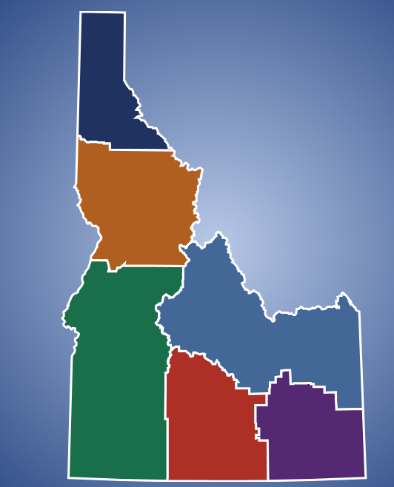
Resource Access Points
Idaho Commission on Aging
Oversee Six Agencies on Aging
https://aging.idaho.gov/
Interactive Resource Map
Search by county to locate local Agency on Aging

Slide 13


Resource Access Points
Support to unpaid caregivers of persons with memory concerns, dementia and Alzheimer’s Disease.
Case Management
Advocacy
Respite
Education
YouTube Channel
ADRD Alliance
Strategic State Plan
Free- “A Workbook for Family Caregivers”
https://healthtools.dhw.idaho.gov/collections/brain-health-alzheimer-s-and-dementias-cards

Slide 14
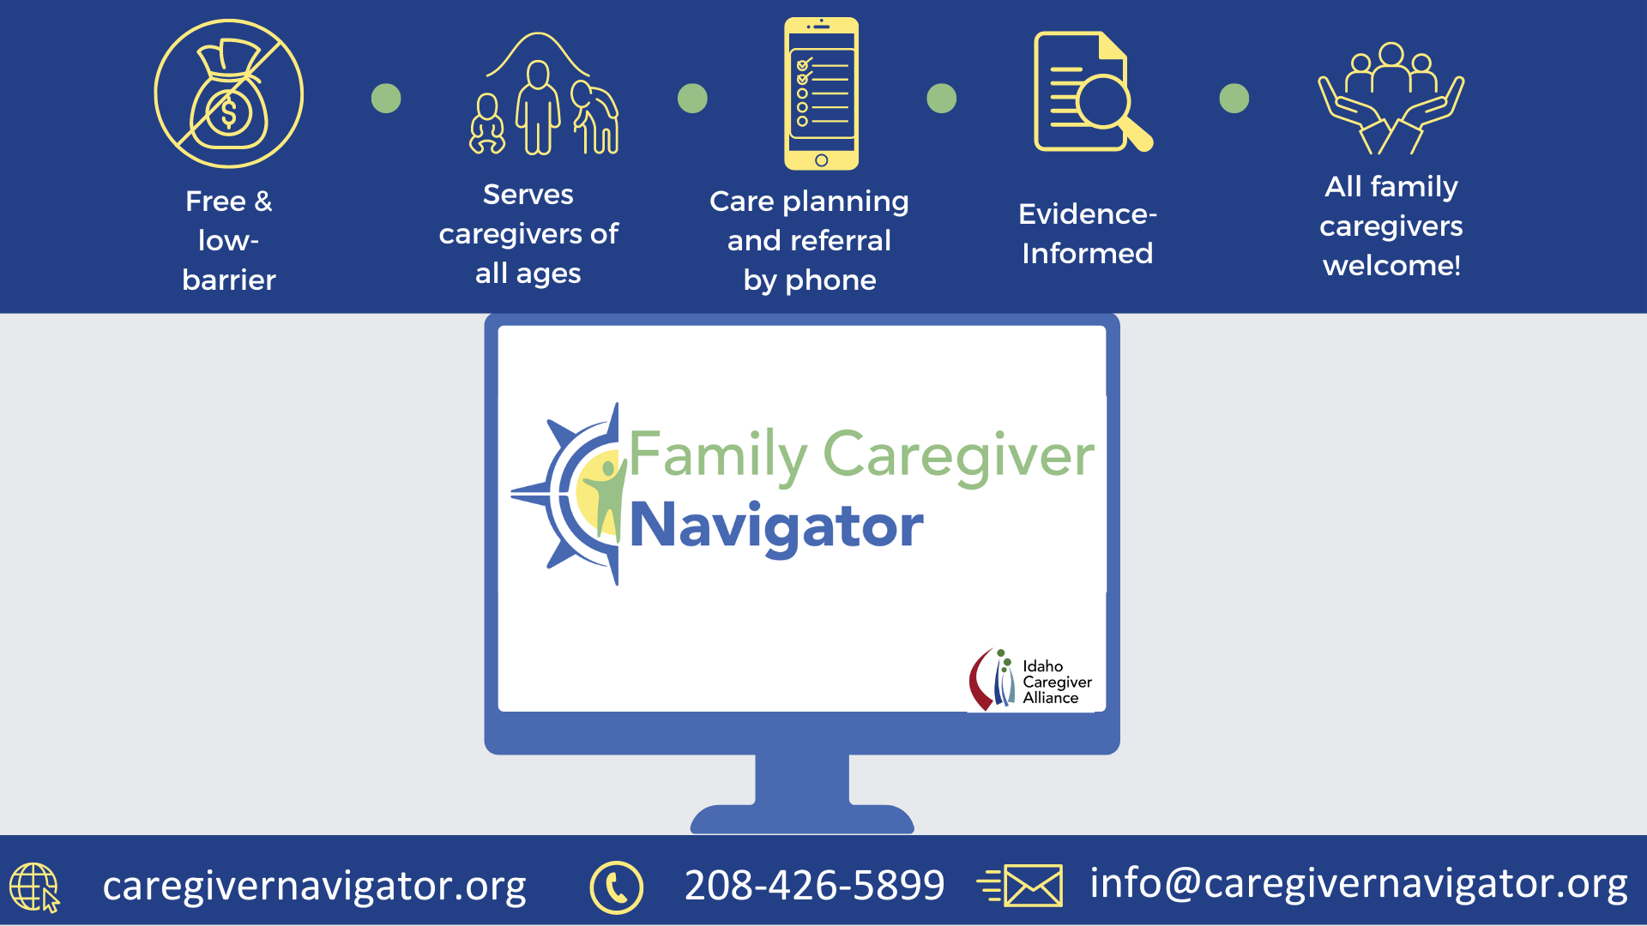
Notes:
SW
A project of the Idaho Caregiver Alliance, the Family Caregiver Navigator is a free service for caregivers and their employers. We have been funded by Medicaid for two years and hope to gain a third year of funding with the aspirations to help as many caregivers as possible and expand statewide. Using the caregiver navigator model (of which I will go into more detail in a moment) our focus is on the caregiver more so than the person receiving care.
We will serve caregivers across the lifespan. What does that mean? Well, we will be helping the first time parents who have a child with intellectual or physical disabilities or is medically fragile, we will be helping the first-generation college student who is working full-time, taking classes at night and is also helping raise her sister’s children, or the sandwiched caregiver who is caring for children at home (best of luck right now if they’re in school virtually) and also caring for a parent or grandparent, or the 65 and older caregiver who may be caring for their spouse, sibling, friend, or neighbor who has chronic illness and is needing more assistance with daily tasks.
The Navigator service is a high-touch telephonic support and resource referral service where we work with the caregiver and meet them where they are at in their caregiving journey. We will run the caregiver through an extensive assessment and from the assessment those answers will be run through an algorithmic method to determine the caregiver’s levels of burden and identity discrepancy.
The service & assessment we are using is an evidence-based intervention that assesses the caregiver’s strengths and needs to match them with the resources that will help them be successful in their caregiving journey.

Slide 15
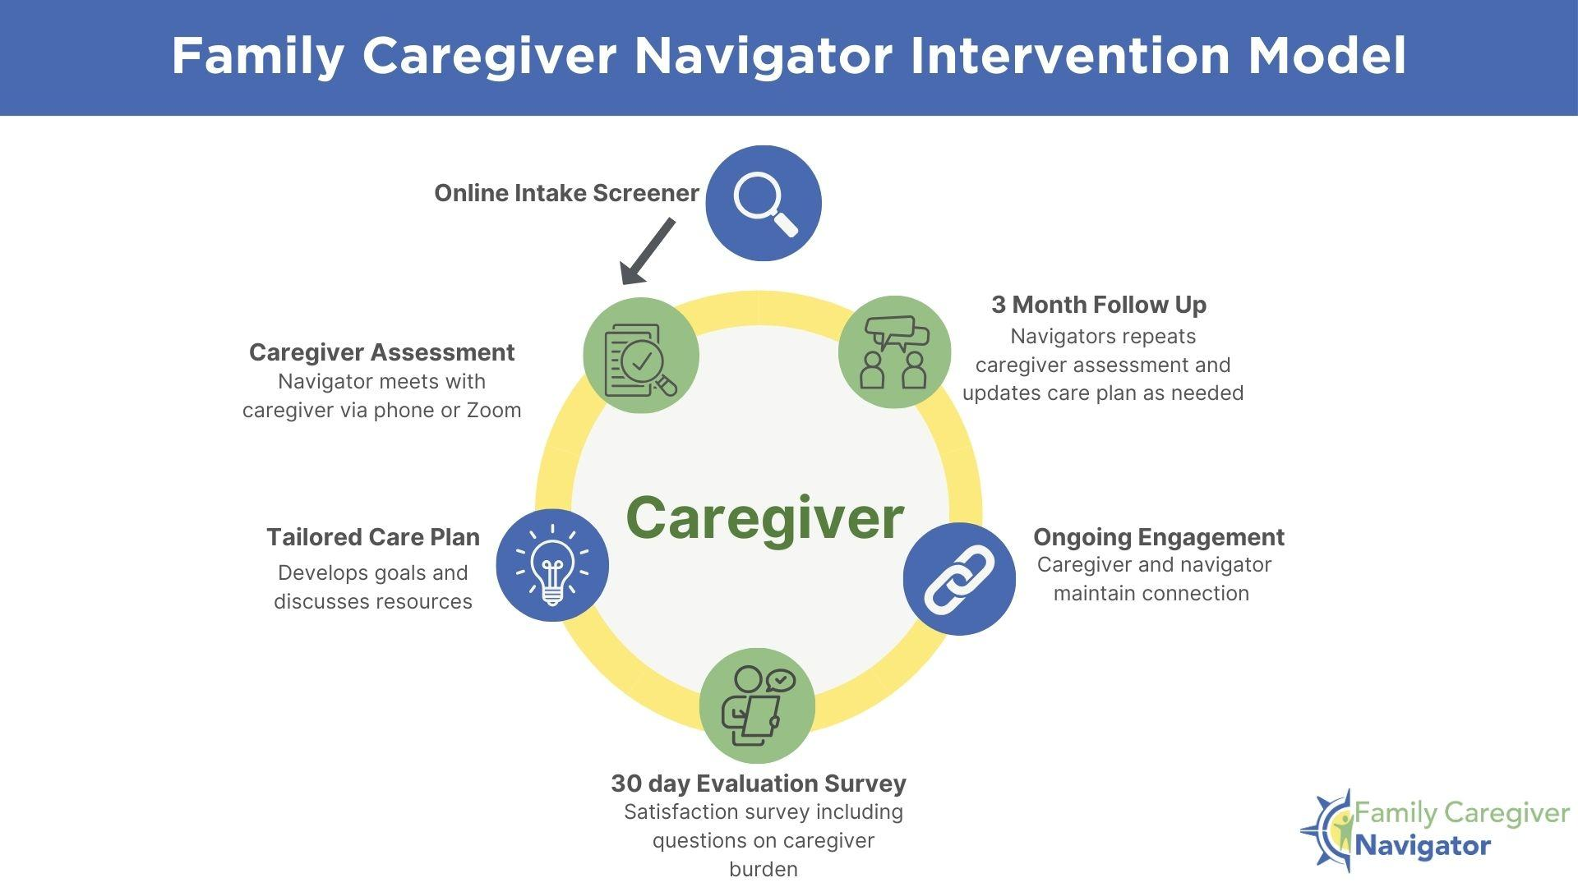

Notes:
SW

Slide 16
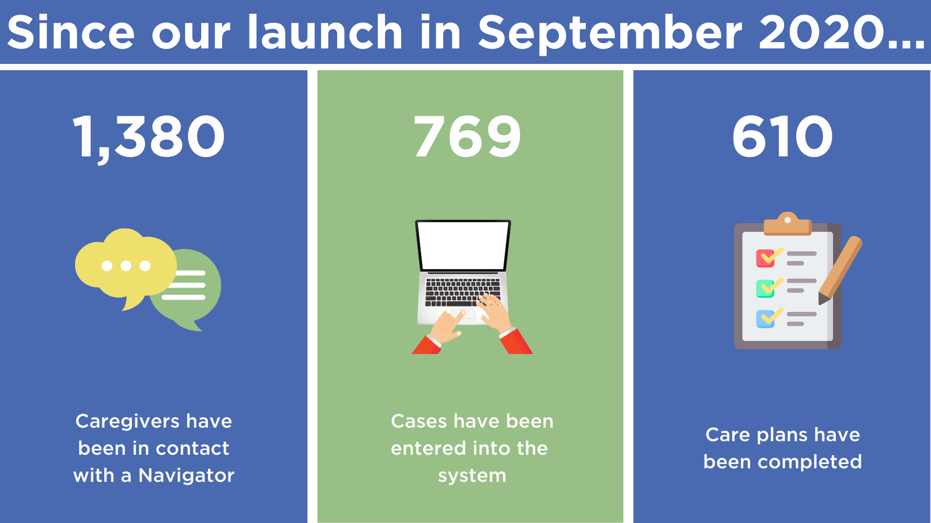
Notes:
SW

Slide 17
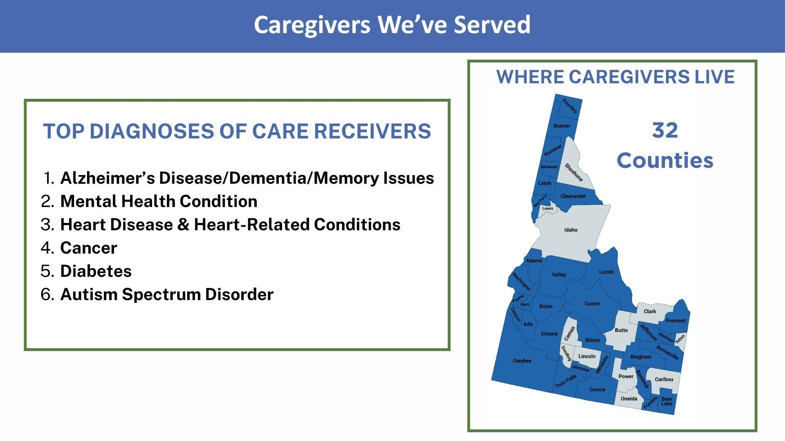

Slide 18
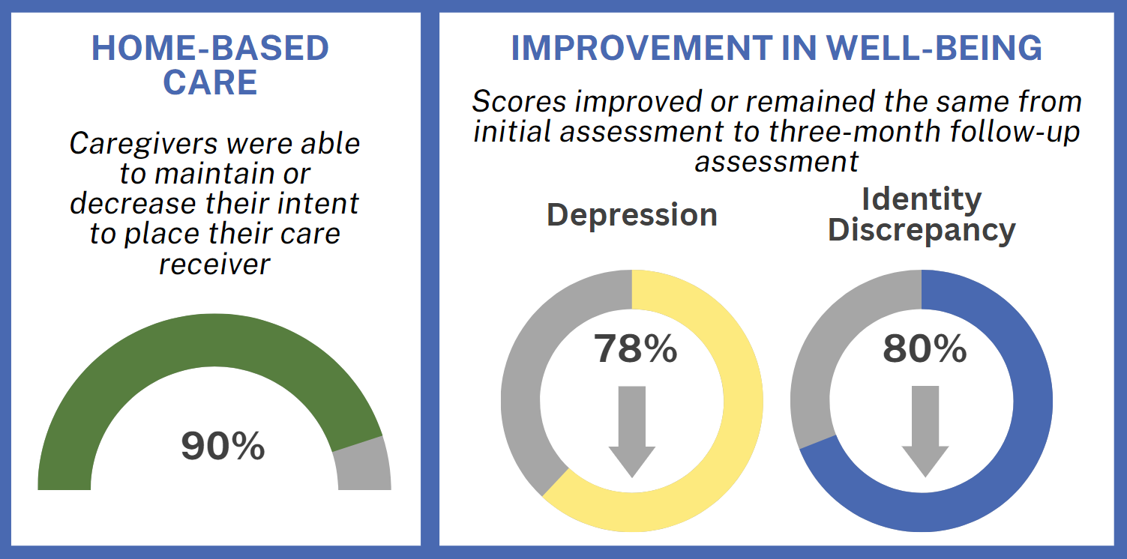

Notes:
SW

Slide 19
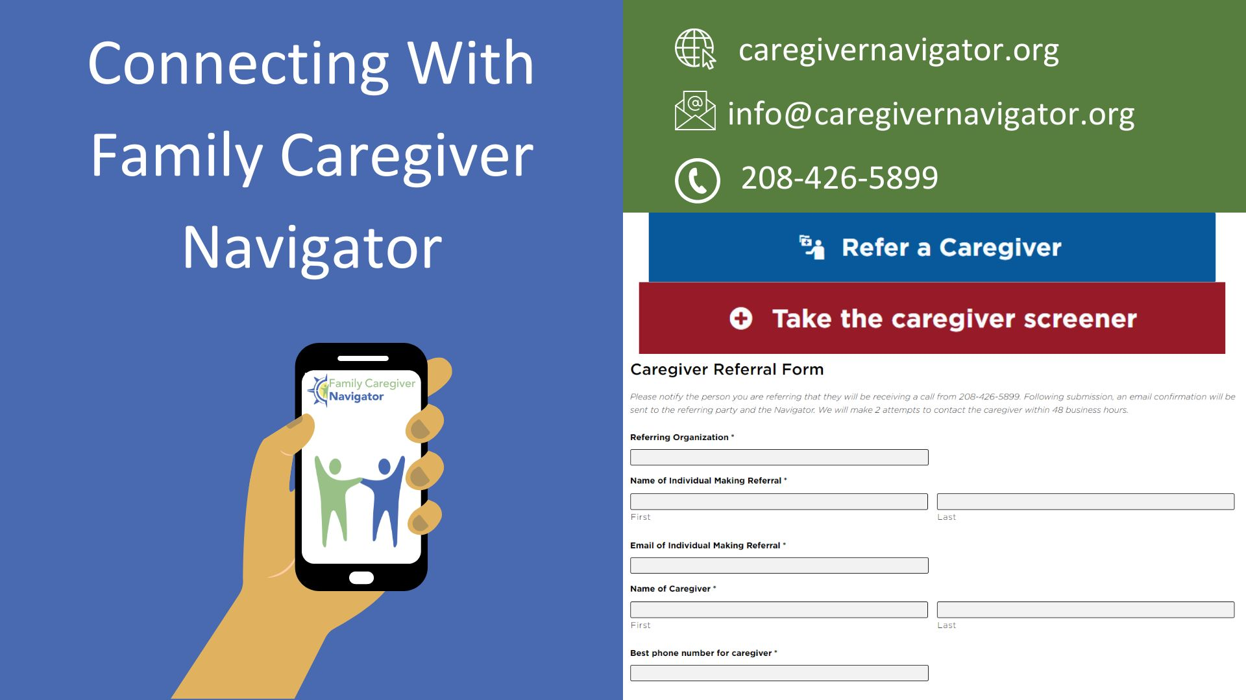

Support Feedback from Audience
Apoyamos a los cuidadores en Idaho
NavegantesIdaho.org
Notes:
SW

Slide 20



Online Search and Referral Tools

Slide 21



Not Just Visitors: Integrating Family Caregivers in Care Delivery and Design

Slide 22




ICA is partially funded by the state of Idaho and the Administration for Community Living (ACL) of the U.S. Department of Health and Human Services (HHS); as part of a financial assistance award (No. 90LRLI0058) totaling four hundred thousand dollars ($400,000) with seventy percent (70%) funded by the ACL/HHS.
FCN was established by the Money Follows the Person Grant 93.791 from the
Centers for Medicare and Medicaid Services.
Disclaimer: The contents of this presentation are those of the author(s) and do
not necessarily represent the official views of, nor an endorsement, by ACL/HHS,
the U.S. Government, Centers for Medicare and Medicaid Services,
the State of Idaho, or the Idaho Department of Health and Welfare.

Slide 23
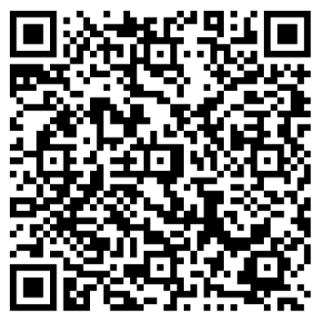
Session Survey:
Notes:
Introduce panel

