Slide 1

CHW’s Frontline Role to Improve Quality Measures
Presented by: Jesus Blanco, Associate Director of Population Health
Idaho Population health Learning Collaborative
November 5, 2025
Boise Idaho

Slide 2
Learning Objectives
Describe TRHS CHWs’ role in addressing SDOHs
Compare TRHS’s historical and current use of CHWs
Apply strategies to direct CHWs toward population health goals
Identify added value CHWs bring to organizations

Slide 3
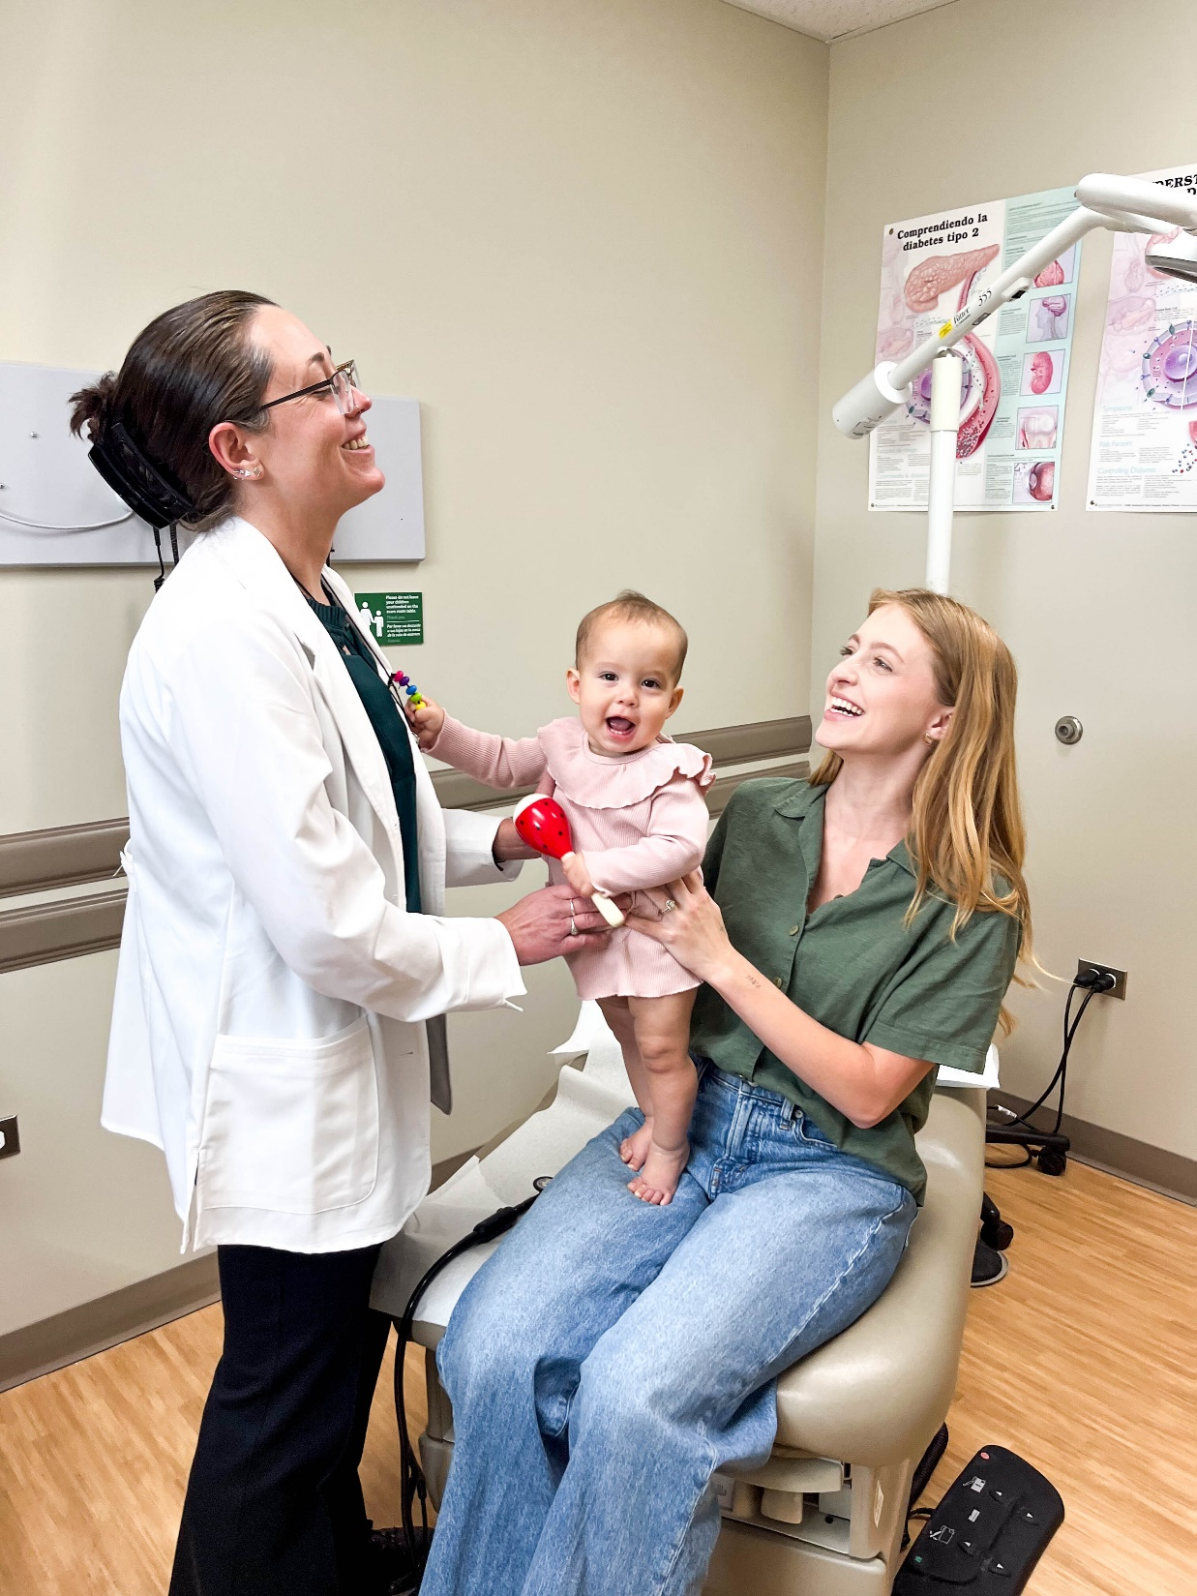
Our Mission
With deep roots in the Treasure Valley, Terry Reilly is a community health center dedicated to providing affordable, accessible care to meet the needs of our community.

Slide 4
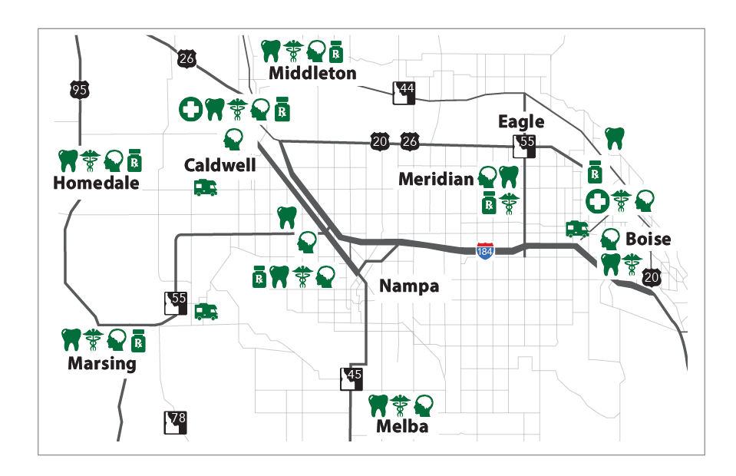
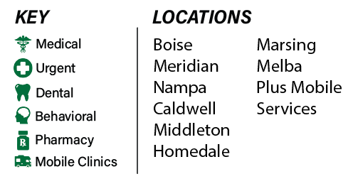
Terry Reilly Locations
Serving the Treasure Valley
16 Locations
3 Counties
8 Cities
42,628 Patients Served Annually

Slide 5



Care for Vulnerable Populations
2024 FY
42,628
Patients per year
Health Care Delivered Through Terry Reilly
48% Medical
23% Behavioral Health
21% Dental
8% Other*
*Patient navigator services, behavioral health consult, Allumbaugh House treatment, case management
197,851
Appointments per year
31%
Lack health care coverage of any kind
Children 7,595
Senior Citizens 5,253
Agricultural Workers 1,980
Homeless Individuals 4,006
Veterans 998
32%
Of patients are living at 100% of the Federal Poverty Level
43%
Of patients are low income

Slide 6
Social Determinates of Health Definitions (SDOH)
There is more to “health” than the physical factors.
The social determinants of health are the conditions in which we are born, live, work, play, and age, and which can affect a broad range of health outcomes including the likelihood of contracting a disease or of dying by a certain age.
Source: Healthy people 2030, health.gov

Slide 7
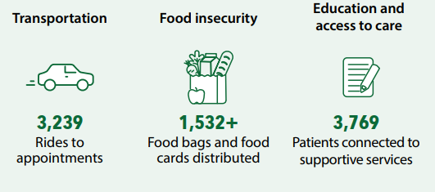
Terry Reilly Address patient SDOHs by
Providing affordable behavioral health, dental, and medical health services
Integrated low-income housing and health care
Medical and Dental Mobile services
Transportation via Lyft to/from TRHS appointments
Patient Navigator services

Slide 8
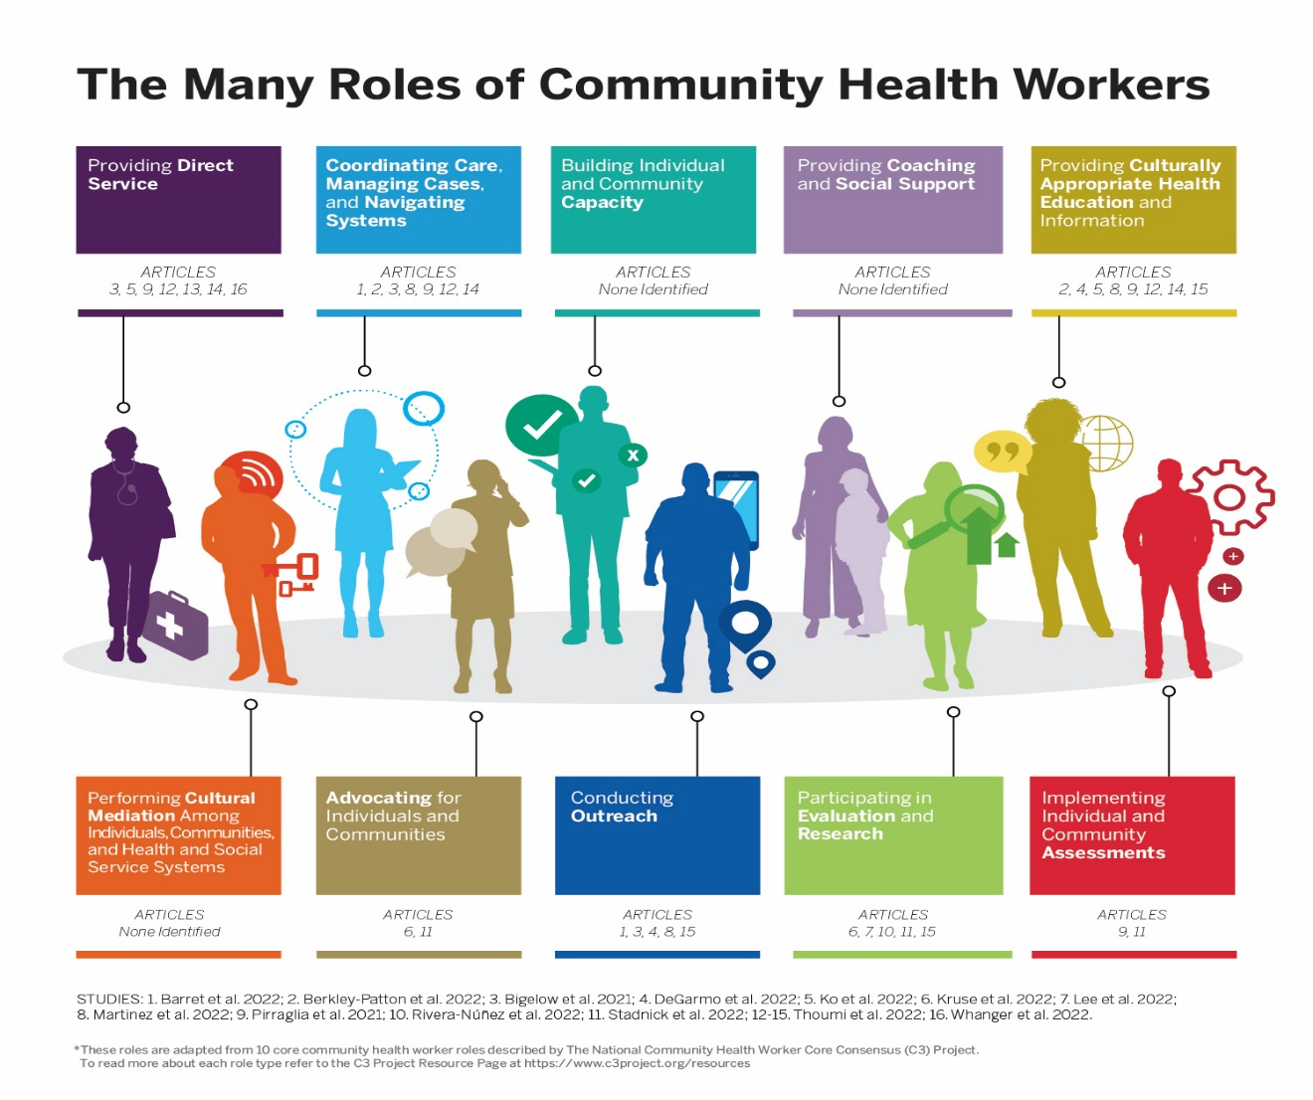
CHWs as “Bridges”
Navigating clients to resources and services
Providing education and skills
Removing barriers that block access to care and “bridging gaps”
Supporting the client with follow-up and follow-through to completing their medical objectives

Slide 9
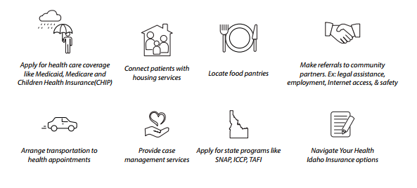
One’s health is dependent on multiple factors
Terry Reilly Patient Navigators are trained to assist patients with the following:

Slide 10
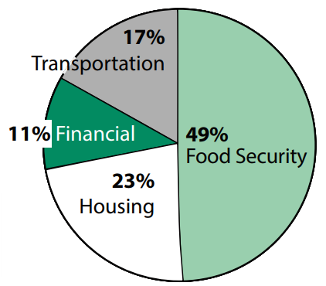

Terry Reilly Patients SDOH Report
In 2024, TRHS Patient Navigators met with nearly
3,769 Patients
connecting them with supportive services, assisting
with insurance enrollment, and scheduling appointments or important preventative screenings.

Slide 11
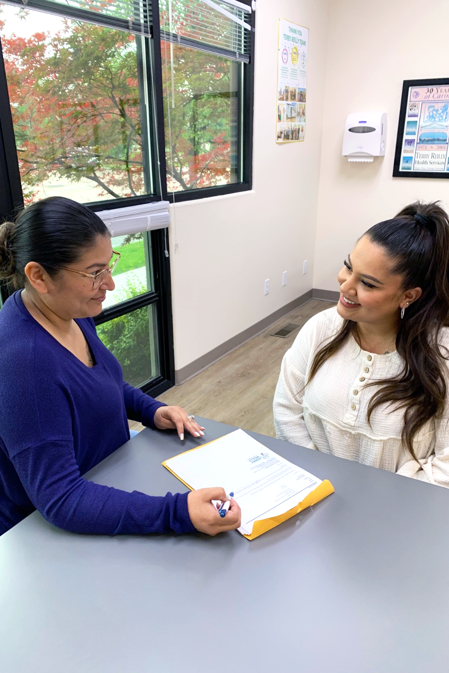

Patient Navigators

Slide 12
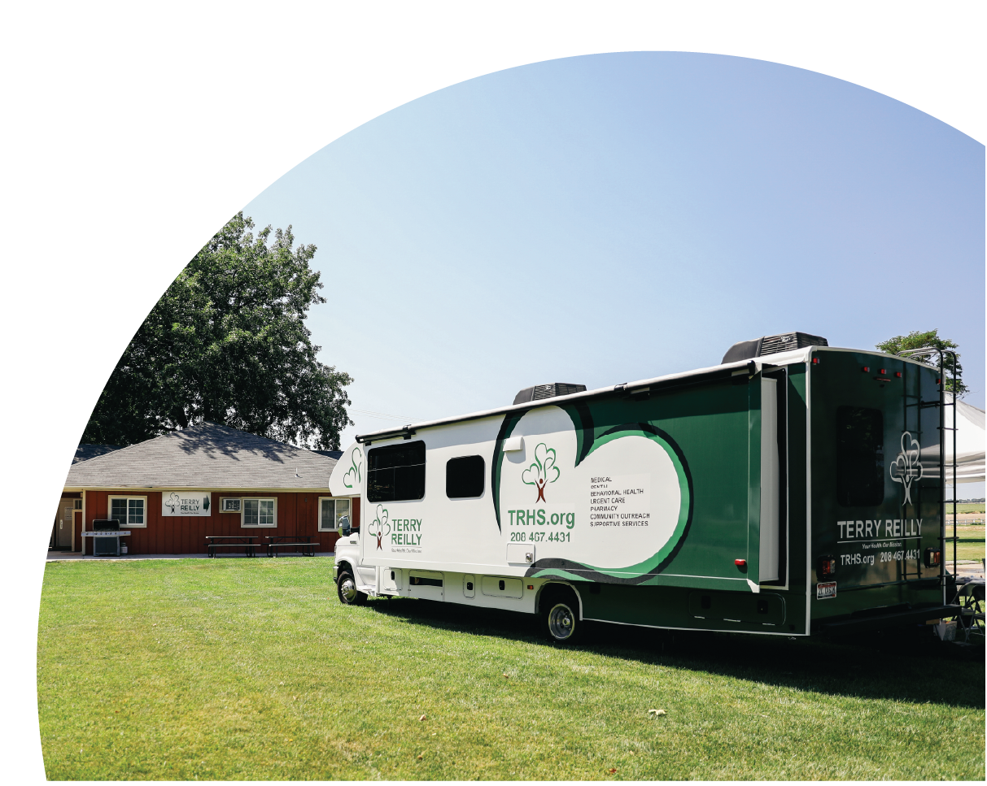
Growth and value of CHWs at TRHS
First CHW hired 1997
  Connect with MSFW community and provide lay health education
  Develop a referral land follow-up process for patients seen at outreach events and mobile health clinics
  Develop, Implement and Manage Promotores program within the MSFW communities.
  Assess the need for and implement patient education programs for MSFW adults and children, especially with regard to diabetes, cardiovascular disease, hypertension, cancer, and obesity.
Three CHWs in 2018-2019
  Name changed from CHW to Patient Navigators
  Insurance expansion focus
  PN moved into clinics to see patients
Seven PNs in 2020
  Pandemic
  Dental and mobile units added
Eighteen PNs todays
  End of Medicaid Coverage Protection
  PN 1, 2, and 3s
  Clinic focus on addressing SDOH
  Outreach/Mobile Units/registry focus
  Home visits/Transportation/BH

Slide 13

Medicaid Expansion
The Affordable Care Act's (ACA) Medicaid expansion expanded Medicaid coverage to nearly all adults with incomes up to 138% of the Federal Poverty Level and provided states with an enhanced federal matching rate (FMAP) for their expansion populations. Idaho expanded Medicaid in 2020.
Medicaid Protection Work
Idaho removed 121,000 people from Medicaid who were likely ineligible, including 77,000 people removed for not providing the state information it had requested.
57,000 Children lost Medicaid Coverage.
Notes:
Slide A/B Patients Work Flow
Central Worklist will be scrubbed by temp employees.
PNs will use scrubbed Central Worklist findings to:
Schedule and assist patients through the Medicaid application process.
Update Medicaid finding in patient CPS record.
Schedule or assist patients with expanded Medicaid coverage to attribute to TR.
Font Desk will give every slide A/B patient that walks in the door a Healthy connections form with scripting. Form will be to temp CHW team for review.

Slide 14

TRHS PN Focuses
PN in outreach (Six staff)
Staff outreach community events
Manage registry outreach and scheduling
Well-Child Visits 0-21
Pediatric immunizations
Medicare Annual Well Visits
Diabetes A1c> 9 or untested
PNs in clinics (Six Staff)
Address SDOH patient needs identified by care teams
Pop Health (3 staff)
Add Hospital records to patient charts and schedule
Add BH Scanned Documents and schedule
Take outbound and Inbound calls for scheduling
Close Small payors gaps

Slide 15
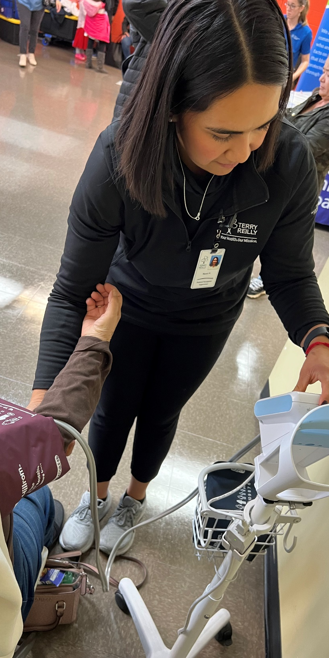
CHW ideal Competencies
Educates individuals and communities about how to use health and social service systems (including explaining how systems operate)
Provides culturally appropriate health education and information
Participates in care coordination or case management, including as part of a team
Provides referrals and follow-up support to ensure that services were obtained
Documents and tracks individual- and population-level data
Identifies and informs people and systems about community assets and challenges
Motivates and encourages people to obtain care and other services
Assists individuals or communities in connecting to resources and advocating for basic needs (e.g. food and housing)
Follows up on health and social service encounters with individuals, families and community groups
Conducts home visits to provide education, assessment and social support
Presents at local agencies and community events to share information and educate individuals and communities about information and educate individuals and communities about health and social service concerns and resources
Evaluates CHW services and programs
Collects and interprets data
Shares results and findings
Engage stakeholders to take action on findings

Slide 16
TRHS essential duties added and used for gap closure
Patient Access Specialist
Schedule and ensure that appointments are confirmed.
Ensure patient demographics are accurate and up to date when scheduling an appointment and upon patient check-in.
Complete data entry into the PM system, which includes scanning and entering of all necessary registration records for each patient.
Manage necessary financial and insurance records on all patients, based upon eligible program and/or insurance coverage. Ensure information is updated in PM system.
Population Health Specialist
Uses available electronic applications to retrieve, document and assemble population health data for analysis and reporting to direct and support corporate population health strategic initiatives, tactics and projects.
Assists care teams on quality improvement methodologies and work toward optimal population health management and gaps in care.
Care coordinators
Make contact with patients who have been identified as being lost to care to help bring them back into care and help with the productivity of providers.
Run monthly reports to identify patients with open care gaps, make contact with the patients to educate them on the need for such service, and notify the medical provider.

Slide 17
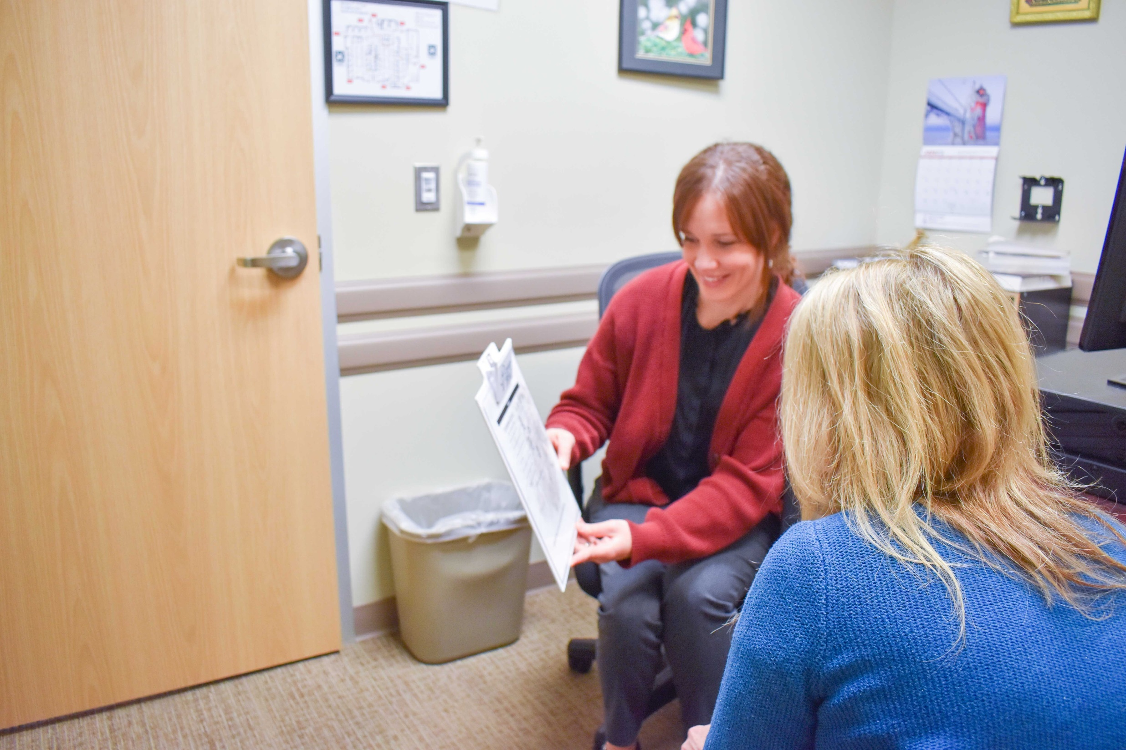
PN Gap Closure by PN in Outreach

Slide 18
Gap Closure Focuses
PN outreach team makes outbound calls to schedule appointments for patients needing Medicare Annual Wellness Visits.
PN outreach team will make outbound calls to schedule appointments for patients not seen in year and missing well care visit.
PN outreach team will make outbound calls to schedule appointments for patients with high A1C and no schedule appointments consistent with care plan.

Slide 19
Gap Closure Check list
Do you focused, validated list of patient to review and call?
Does your team have the adequate training for success?
Do you have a workflow to document progress, success and barriers?
Have you carved the needed time to call patients?
Are you impacting a payer gap, UDS or QI or grant measure?
Are you part of any care gap closure quality committee or incorporated in a clinical team that will receive updates on progress?
Who else in your organization is working to close the care gap? Can you partner and add CHW value to their work?

Slide 20
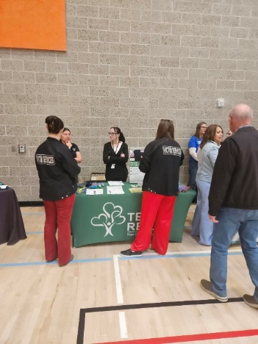
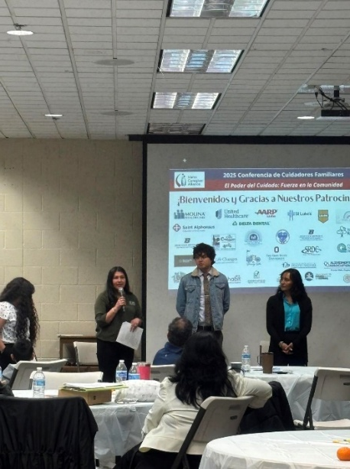
Outreach Team Highlights
TEAM
Jesus Blanco Associate Director of Pop Health
Nanci Paz PN Supervisor - PRC
Sandra Valdez PN Lead - PRC
Crystal Ortiz PN 3 – PRC
Ginger Ewing PN 2 - PRC
Gabriela Cardenas PN 2 – PRC
Samantha De Leon PN 2 - PRC
BY THE NUMBERS
Registry Totals – 18,620
New to TRHS
Not seen in year 0-65
Medicare Annual Wellness Visit 65 Plus
A1C greater than 9
Total Contacted – 9,653
UTC/Bad Number – 2,941
Total appointments scheduled – 2,124
SPECIAL PROJECTS HIGHLIGHTS
St Alphonsus Mammo Bus Partnership: PN took over coordination of this activity from Nursing - St Alphonsus current provides mobile mammogram services to 9 our locations. Our goal is to increase access to mammograms for our underinsured and uninsured patients. Total clinics – 10
Parma Mobile Dental Clinic: PNs teamed up with the school district to identifying family who are needing dental services and education staff and others on the availability of our services. Our mobile clinic goes out to Parma once a month for dental services and has a Patient Navigator on staff.
Farmway- Fresh Produce for Seniors: PNs partnered with City of Good to bring fresh produce to Seniors who reside at Farmway village and are faced with food insecurity and low access to fresh produce. Fresh produces are delivered biweekly from May- November, PN assist City of Goods with deliveries and hosted activities to help reduce loneliness and isolation among seniors.

Slide 21
Registries and patient impact
Date received | Registry | Registry total | Date completed | Contacts Made | Bad Numbers | Call not needed | Total Scheduled
3/27/2024 | March HC new enrollees | 239 | 4/1/2024 | 101 | 111 | 24 | 13
3/28/2024 | Medicare AWV | 2616 | 8/12/2024 | 1537 | 312 | 767 | 394
4/17/2024 | April Medicaid HC hard&softmatches | 3264 | 6/27/2024 | 1349 | 416 | 1509 | 476
6/18/2024 | June HC new enrollees | 311 | 7/29/2024 | 79 | 183 | 48 | 13
7/10/2024 | UHC High Priority July 2024 | 129 | 8/7/2024 | 25 | 11 | 56 | 12
7/1/2024 | Medicare AWV- July 2024 | 2487 | In progress | 414 | 233 | 1157 | 155
7/1/2024 | UHC Unmatched | 80 | 9/10/2024 | 79 | 15 | 1 | 1
7/1/2024 | A1C | 611 | 11/6/2024 | 364 | 94 | 245 | 76
10/10/2024 | HC September Roster | 633 | 12/9/2024 | 532 | 176 | 101 | 69
11/20/2024 | HEDIS- WCV November | 39 | 12/24/2024 | 14 | 6 | 25 | 3
12/19/2024 | WCC 0-15month | 2018 | 2/7/2025 | 1710 | 619 | 296 | 225
1/7/2025 | 12.2024 HC Unmatched | 1726 | 3/11/2025 | 629 | 117 | 631 | 290
2/20/2025 | January HardMatch - Azara | 446 | 3/18/2025 | 301 | 56 | 72 | 50
2/25/2025 | Febuary MDC HC Unmatched | 109 | 3/17/2025 | 87 | 21 | 22 | 28
3/12/2025 | A1C | 1437 | 4/8/2025 | 1006 | 258 | 415 | 193
3/17/2025 | AZARA 19-64 | 401 | 5/16/2025 | 264 | 49 | 90 | 25
4/1/2025 | Medicare Annual Wellness | 299 | 5/15/2025 | 209 | 38 | 55 | 18
5/2/2025 | 4.2025 Unmatched | 384 | 5/22/2025 | 166 | 41 | 218 | 60
5/9/2025 | WCC May 0-18 | 65 | 5/14/2025 | 49 | 14 | 16 | 15
5/14/2025 | West Valley Mammogram | 1295 | 7/7/2025 | 721 | 169 | 174 | 15
5/27/2025 | May wellness | 18 | 6/10/2025 | 13 | 1 | 4 | 2
5/29/2025 | May Unmatched | 13 | 7/7/2025 | 4 | 1 | 0 | 0
 | Totals | 18620 |  | 9653 | 2941 | 5926 | 2124

Slide 22
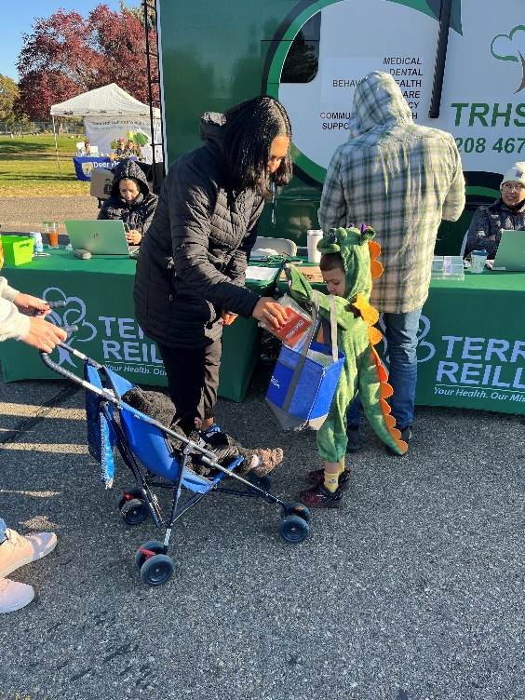
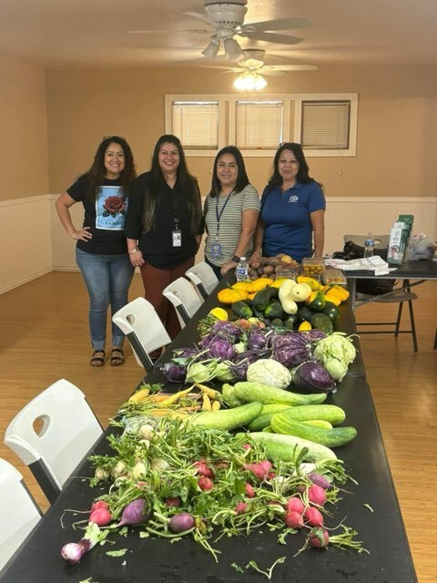
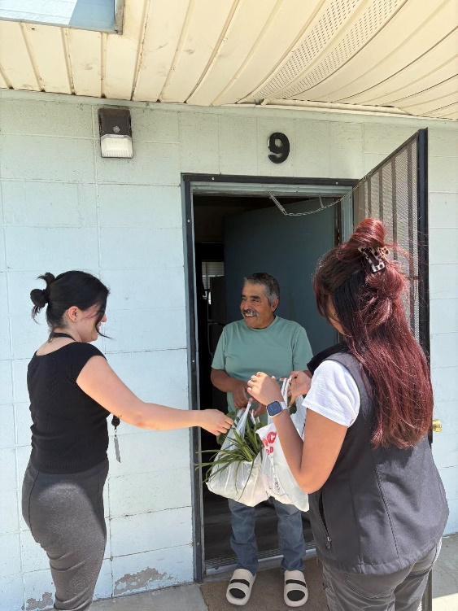
Why add CHWs
CHWs walk beside the patient:
Bridging Health Systems and Advocacy… One form, One patient, One miracle at a time.
Teaching patients to Fish and speak up when patients can’t
Forms, Phone Calls and Fill in the health care literacy gaps

Slide 23

How can I use CHWs at my organization
Help patients' clients understand changing program eligibilities and what is needed to successfully navigate your health care offerings
Leverage Idaho Medicaid Managed Care opportunities coming in 2026
Leverage Community Health Integration billing for Medicare Annual Wellness Visits
Add additional value to your population health focuses

Slide 24

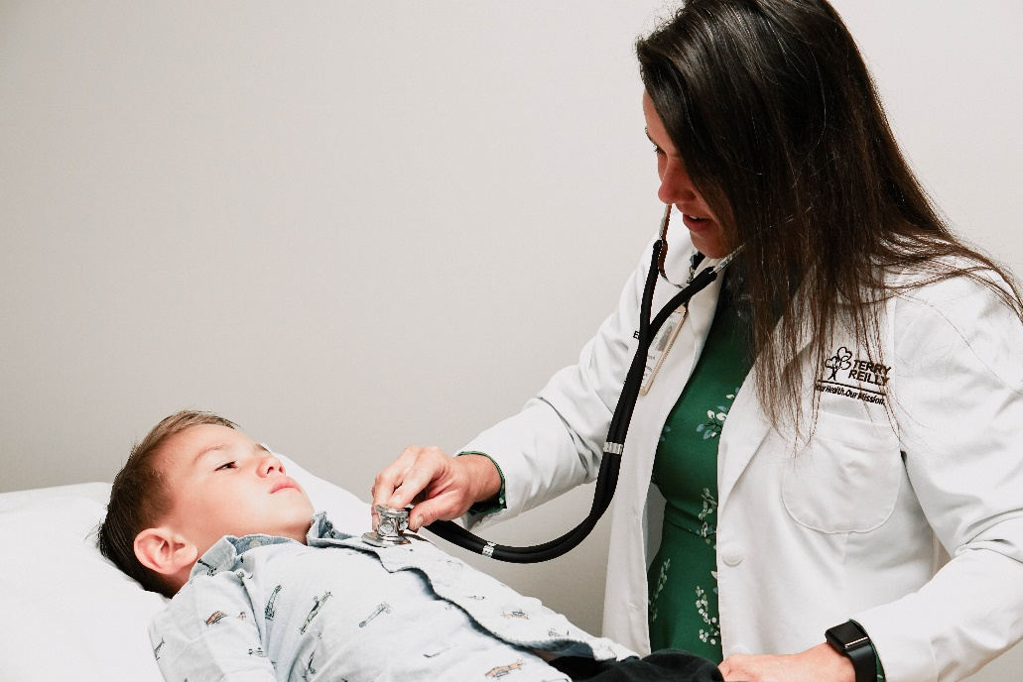
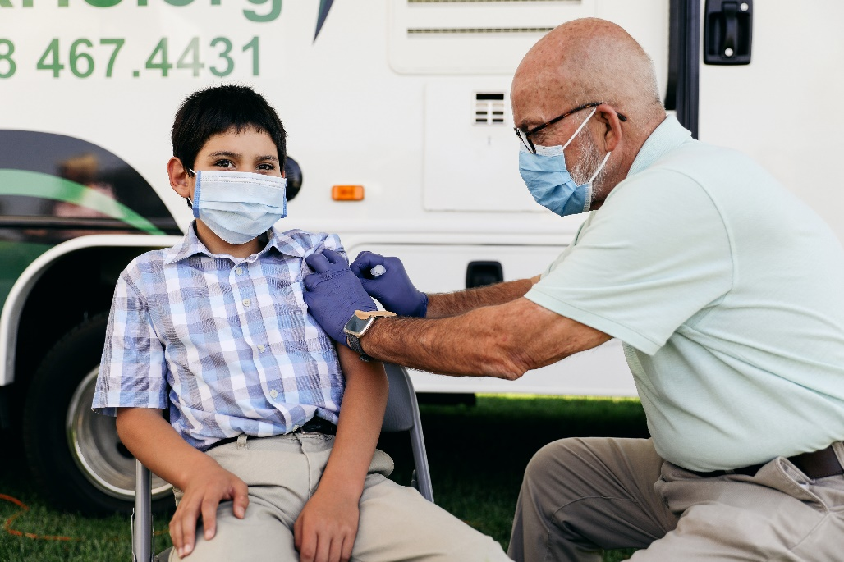
Thank you!

Slide 25
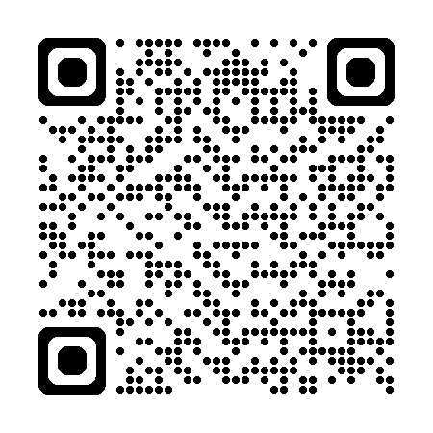
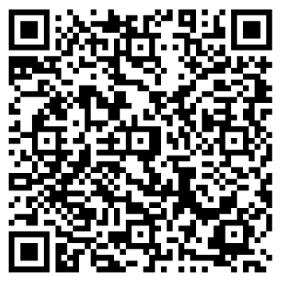
Session Survey:
CME Credit:

