Slide 1

Preadmission Screening and Resident Review
Notes:
Attending:
Dustin Killpack - Division of Medicaid
Michelle Fink - Division of Medicaid
State surveyors
Employees from the Mental Health Department

Slide 2
Objectives
Understand the intent and core objectives of the PASRR Program
Examine the relationship between the MDS assessment process and PASRR compliance
Identify clinical indicators and documentation triggers that initiate a surveyor review
Review the specific federal regulatory tags (F-tags) governing PASRR compliance
Locate and utilize official resources and reference materials for ongoing guidance
Notes:
Understand the PASRR program
Understand the MDS & PSRR work together
What triggers the state surveyor to investigate
PASRR resources

Slide 3
CFR 42 483.102 Applicability and definitions
This subpart applies to the screening or reviewing of all individuals with mental illness
or intellectual disability who apply to or reside in Medicaid certified NFs regardless of
source of payment for the NF services, and regardless of the individual’s or resident’s
known diagnoses.
An individual is considered to have a serious mental illness (MI) if the individual meets
the following requirements on diagnosis, level of impairment and duration of illness:
A schizophrenic, mood, paranoid, panic or other severe anxiety disorder, somatoform
disorder, personality disorder, other psychotic disorder, or another mental disorder that
may lead to a chronic disability, but not a primary diagnosis of dementia, including
Alzheimer’s disease or a related disorder, or a non-primary diagnosis of dementia unless
the primary diagnosis is a major mental disorder as defined in paragraph.
Notes:
CFR = Code of Federal Regulations
The requirement was established by the Nursing Home Reform Act, which was passed as part of the Omnibus Budget Reconciliation Act of 1987 (OBRA ‘87)
Screening for those with MI or ID
Required for Medicaid certified nursing facilities regardless of the resident’s payor source or dx.
January 1, 1989: States were required to implement preadmission screening programs for all nursing facility applicants to identify those with serious mental illness (SMI) or intellectual disabilities (ID).

Slide 4
PASARR / PASRR
PASARR
1990: States were required to begin annual resident reviews = PASARR (Pre-Admission Screening and Annual Resident Review).
PASRR
1996: There was a transition from the PASARR to PASRR because a federal law removed the requirement for annual resident reviews (now triggered by a "significant change in condition") for existing residents.
While the law changed in 1996, you may still see both terms used because the official Code of Federal Regulations (CFR) has not been fully updated to reflect the 1996 legislative change.
Notes:
April 1, 1990: States were required to begin annual resident reviews = PASARR (Pre-Admission Screening and Annual Resident Review).
1992: Federal regulations for PASRR were finalized, further refining the screening process.
1996: There was a transition from the PASARR (Pre-Admission Screening and Annual Resident Review) to PASRR (Pre-Admission Screening and Resident Review) because a federal law removed the requirement for annual resident reviews (now triggered by a "significant change in condition") for existing residents.
While the law changed in 1996, you may still see both terms used because the official Code of Federal Regulations (CFR) has not been fully updated to reflect the 1996 legislative change.
CMS uses the MDS to track PASRR information.

Slide 5
The Minimum Data Set (MDS) Assessment
The Minimum Data Set (MDS) is a federally mandated, standardized clinical assessment tool used in Medicare/Medicaid-certified nursing homes to evaluate the functional, medical, and psychological status of residents.
It drives care planning, quality improvement, and reimbursement, with version 3.0 (implemented 2010) focusing on accuracy and resident voice.
Notes:
The MDS 3.0 was implemented in 2010 and started focusing on accuracy and resident voice.
The MDS drives care planning, quality improvement, and reimbursement.
-The following slides are parts of the MDS assessment that triggers the surveyor to investigate a Resident’s PASRR and/or Dx. (A1500, Section I- Dx, Medications)

Slide 6
Key MDS Items for PASRR
A1500 (PASRR Level II Evaluation): Identifies if the resident has been evaluated by the state Level II PASRR process and currently has an active PASRR condition.
Code 0: No (skip to A1550)
Code 1: Yes (continue to A1510)
Code 9: Not a Medicaid-certified unit (skip to A1550)
A1510 (PASRR Conditions): Specifies which condition was identified during the Level II evaluation (check all that apply):
A. Serious Mental Illness (SMI)
B. Intellectual Disability (ID)
C. Other Related Conditions(RC)
A1550 (Conditions Related to ID/DD Status): Asks about specific conditions such as Down syndrome or Autism, even if a Level II PASRR was not triggered.
Notes:
A1500: Is the resident currently considered by the state level II PASRR process to have serious mental illness and/or intellectual disability or a related condition?
Chapter 3 of the RAI Resident Assessment instrument manual has information on how to answer these questions. October 2025 update version. 30-day exemption
The PASRR was put in place & is tracked on the MDS to :
ensure proper care coordination & compliance with state and federal oversight
MMI & ID are also tracked on the MDS because :
CMS monitors MDS data to catch spikes in these specific diagnoses. If a facility's reported percentage of residents with schizophrenia suddenly shifts on the MDS, it triggers targeted federal audits to ensure the facility is not miscoding residents to artificially lower their antipsychotic drug rates = adjustment on your 5-star quality ratings. “Schizophrenia Audits”
The long-stay antipsychotic Quality Measure (QM) explicitly excludes residents diagnosed with schizophrenia, Huntington’s disease, or Tourette syndrome. Because a schizophrenia diagnosis protects a facility's public star rating, CMS uses data-driven method to flag nursing homes with statistical deviations..
CMS conducts aggressive off-site and on-site antipsychotic audits on nursing homes, heavily targeting facilities suspected of miscoding diagnoses to mask medication rates.

Slide 7
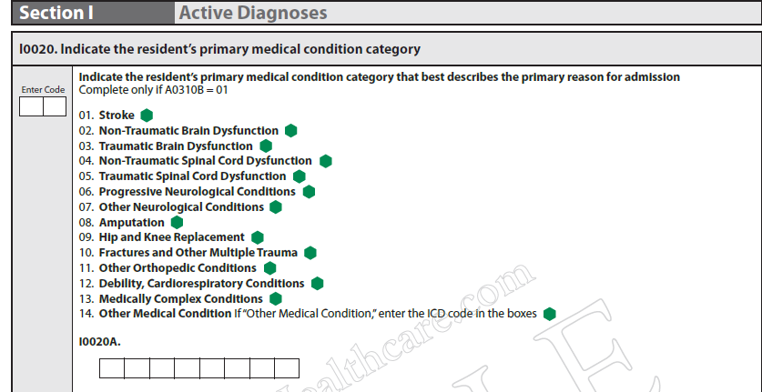
Section I 10020 Primary Diagnosis
Notes:
I0020: is the Resident’s PRIMARY Active Dx.
— Code 02, Non-Traumatic Brain Dysfunction, if the resident’s primary medical condition category is non-traumatic brain dysfunction. Examples include Alzheimer’s disease, dementia with or without behavioral disturbance, malignant neoplasm of brain, and anoxic brain damage.
Chapter 3 of the RAI manual.
The PASRR Level II is still done if the primary dx. is Dementia if the resident is on psychotropics or have Mental Health /ID. They may still benefit from special services.
When a resident stays past a 30-day exempted hospital discharge, the nursing home must complete a Level II PASRR resident review within 40 calendar days of the initial admission date.

Slide 8
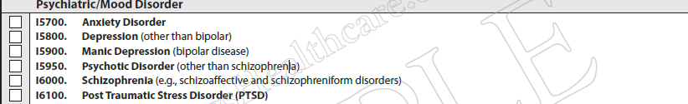
Active Diagnoses in the last 7 days
Section I: Active Diagnoses
Notes:
Dx in the last 7 days
Under Neurological :I 4200 you have Alzheimer’s disease.
The PASRR Level II is still done if the primary dx. is Dementia if the resident is on psychotropics or have Mental Health /ID. They may still benefit from special services.

Slide 9
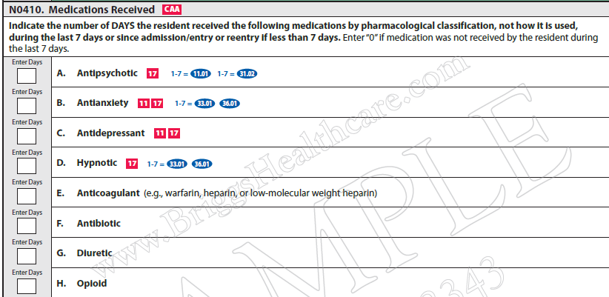
Other areas on the MDS that trigger for the Surveyors
Section N: Medications
Notes:
Medications without the proper dx will trigger the surveyor to look into the PASRR and/or MDS.
Next slide shows what we see as surveyors.

Slide 10
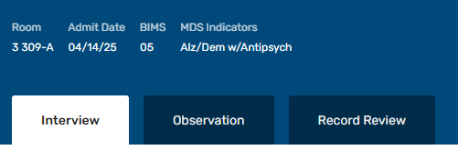
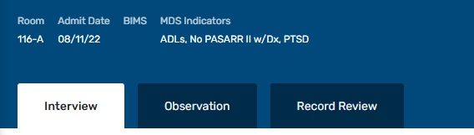
What triggers the surveyor to investigate the PASRR
Notes:
Next slide is one of the F-tags cited.

Slide 11
F645 PASRR Screening for MD & ID
Level I Screening: Identifies if the applicant has a possible serious mental illness, intellectual disability, or related condition. This is done before the resident is admitted.
Level II Evaluation: An in-depth assessment conducted by the state if a Level I screen triggers. This step determines the most appropriate care setting and if specialized services are necessary.
Surveyor Guidelines:
Pre-Admission Completion: The screening was done before the resident moved into the facility.
No Inappropriate Placement: The resident is not placed in the nursing home if they could safely live in the community or if their needs are too acute.
Specialized Services: The resident receives the specific services outlined in their Level II evaluation.
Notes:
Was it done BEFORE admission?
We don’t cite if the date is not correct or the name of the facility is not correct.
We have accepted PASRRs from other states.
Is it correct?
Did they have special services recommended and received?
Did they have a 30-day exemption and after the 30 day another PASRR was completed if they were still in the facility?
Action Steps and Timelines
Submit Level I Screen: The facility must submit an updated Level I screen or referral as soon as it is clear the stay will exceed 30 days, and ideally before the 30th day.
Complete Level II Evaluation: The state mental health or intellectual disability authority must finalize the Level II determination no later than the 40th calendar day from the day the resident first walked through the door.
Do Not Wait: Facilities do not need to wait until day 30 to start the paperwork; they can and should submit the request early once an extended stay becomes apparent.

Slide 12
F646 MD/ID Significant Change Notification
Surveyor Guidance:
During a survey, inspectors check whether the facility properly identified and reported the change.
Medical Record Review: Surveyors look at clinical notes to see if a significant change occurred.
State Authority Referral: Inspectors check if the facility actually notified the state agency.
MDS Accuracy: Surveyors verify if the Minimum Data Set (MDS)—the standard screening tool used in nursing homes—was coded correctly to reflect the resident’s current clinical status.

Slide 13
Significant changes are:
Will not normally resolve itself without intervention.
Is not "self-limiting" (for declines).
Impacts more than one area of the resident's health status.
Requires interdisciplinary review and/or care plan revision
Notes:
Review Chapter 2 of the RAI manual for what is a significant change.
New psych dx requires a PASRR level II
Another F tag = F 641 - Accuracy of Assessment - This is referring to the MDS.

Slide 14
PASRR Level II Clarification
The title of the HW0090 1.5 PASRR Screen for NF Admission has been updated to HW0090 Abbreviated Level 2 PASRR Screen for NF Admission. The update is to relieve confusion over what is considered a PASRR Level 2 diagnosis. (February 2018)
If a participant has an Abbreviated Level 2 (formally Level 1.5), this participant has a Level 2 diagnosis related to mental health or intellectual disability. Nursing facilities are expected to address if a participant has a Level 2 diagnosis in the Minimum Data Set (MDS), if the participant was admitted with a Level 1 and an Abbreviated Level 2, the participant should have items A1500 marked ‘Yes’ and A1510 should be marked accordingly.
Notes:
It is important to completed the PASRR Level I correctly.
This determines if a PASRR Level II needs to be done.
PASRR Level 1 = 87
PASRR Level II = 90 (Abbreviated)
Why is it called Abbreviated ?
The Idaho Department of Health and Welfare's HW0090 form is called "Abbreviated" because it represents an Abbreviated Level II PASRR evaluation.
Under federal Medicaid regulations (42 CFR § 483.130), a full, highly extensive Level II psychiatric evaluation can be bypassed or shortened into an abbreviated review if a resident meets specific, clear-cut clinical scenarios. The Idaho Medicaid program updated this form's title explicitly to relieve clinical confusion over what constitutes a standard vs. shortened Level II diagnosis.

Slide 15
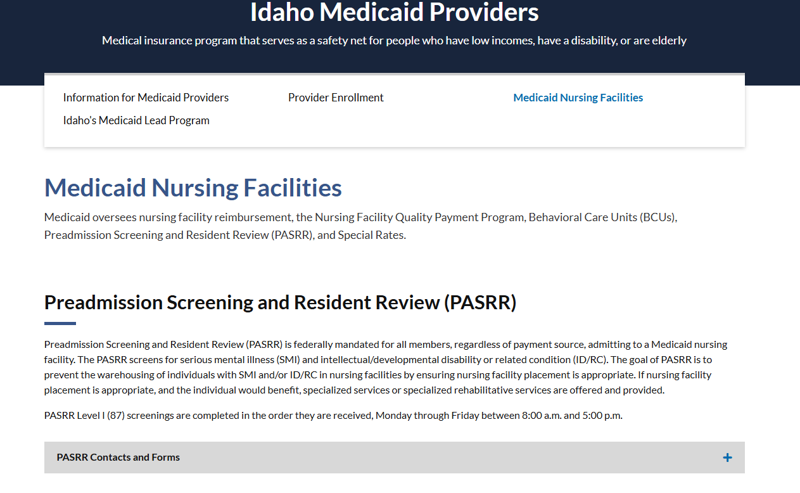
Where to go to get PASRR Information
healthandwelfare.idaho.gov/providers/idaho-medicaid-providers/medicaid-nursing-facilities
Notes:
. https://healthandwelfare.idaho.gov/providers/idaho-medicaid-providers/medicaid-nursing-facilities

Slide 16
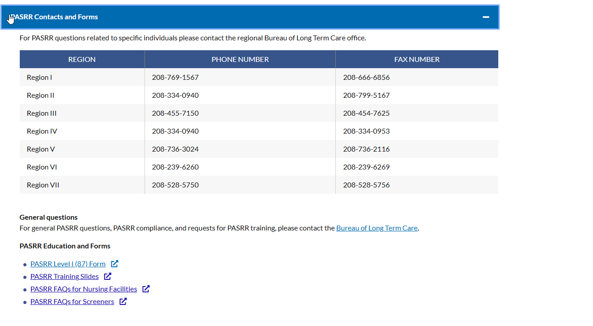
PASRR Contacts and Forms takes you to here
Notes:
The PASRR Training Slides are good to review even though it is from 2019.
Slide 49 is very helpful.

Slide 17
Questions?
Q: A resident has a primary diagnosis of dementia and is exempt from specialized services, but our facility primary diagnosis is not dementia it's a left hip fracture do we need to resubmit the PASSR?
A: On the PASRR form the “Primary Diagnosis” is referring to the primary diagnosis for the medication not the primary diagnosis for the resident being admitted to the facility.
Q: If a resident starts a new antipsychotic medication (meaning they had not been on an antipsychotic medication before), we are to do a significant change MDS within 14 days, the PASRR was sent for review/update but we may not get it back within the 14 days. Do we still mark yes to level 2 since we have sent it in but, have not received it back?
A: Review Chapter 2 of the RAI manual (A1500/ Significant Change Guidelines).
A1500 states: Is the resident currently considered by the state Level II PASRR process to have serious mental illness and/or intellectual disability or a related condition?
Do they already have a PASRR Levell II? Check the answer based on that PASRR Level II.
If you have not received the PASRR Level II back yet you would mark 0.No, because you don’t know if the resident currently considered by the state Level II PASRR process to have serious mental illness and/or intellectual disability or a related condition.
Notes:
Reference list: MDS 3.0 RAI User's Manual, Chapter 2 details the regulatory criteria for a Significant Change in Status Assessment (SCSA).
Chapter 3 provides the item-by-item coding instructions for the MDS data fields.

Slide 18
Questions cont.
Q: Does a facility-to-facility transfer require a new PASRR if there are no changes in condition?
A: 42 CR 483.106 (b)(4): No, a facility-to-facility transfer within the same state does not require a new PASRR screening or evaluation if there has been no significant change in the resident's physical or mental condition.
Q: If a resident is on an antidepressant and switch to a different antidepressant, do we need an updated PASRR?
A: No
Q: Where is the 30-day exception is supposed to be documented?
A: If the attending physician at the hospital has certified that the resident is likely to require less than 30 calendar days of NF services it is marked on the PASRR Level I. This is sent to the NF with the resident and saved in the resident’s medical record.
Q. Do we need the Level 1 submitted prior to admit if they only have a Level 1 or does that just go for the Level 2’s?
A: If the resident only has a PASRR Level I, they must have that prior to admit.
** If you have submitted a PASRR to Medicaid (for whatever reason) put a progress not in the resident’s chart, save the email, somehow show proof that you are working on getting the PASRR done.
Notes:
Reference list entry: Preadmission Screening and Resident Review, 42 C.F.R. § 483.106(b)(1)-(2) (2026).

